Slide 1
Introduction to SQL
Select-From-Where Statements
Multirelation Queries
Subqueries

Slide 2
Why SQL?
SQL is a very-high-level language.
  Say “what to do” rather than “how to do it.”
  Avoid a lot of data-manipulation details needed in procedural languages like C
Database management system figures out “best” way to execute query.
  Called “query optimization.”

Slide 3
SELECT Statement
  SELECT [DISTINCT | ALL]
  {* | [columnExpression [AS newName]] [,...] }
  FROM TableName [alias] [, ...]
  [WHERE condition]
  [GROUP BY columnList] [HAVING condition]
  [ORDER BY columnList]

Slide 4
SELECT Statement
FROM Specifies table(s) to be used.
WHERE Filters rows.
GROUP BY Forms groups of rows with same
  column value.
HAVING Filters groups subject to some
  condition.
SELECT Specifies which columns are to
  appear in output.
ORDER BY Specifies the order of the output.

Slide 5
SELECT Statement
Order of the clauses cannot be changed.
Only SELECT and FROM are mandatory.

Slide 6
Literals
Literals are constants used in SQL statements.
All non-numeric literals must be enclosed in single quotes (e.g. ‘London’).
All numeric literals must not be enclosed in quotes (e.g. 650.00).

Slide 7
* In SELECT clauses
When there is one relation in the FROM clause, * in the SELECT clause stands for “all attributes of this relation.”
Example: Using Beers(name, manf):
SELECT *
FROM Beers
WHERE manf = ’Anheuser-Busch’;

Slide 8
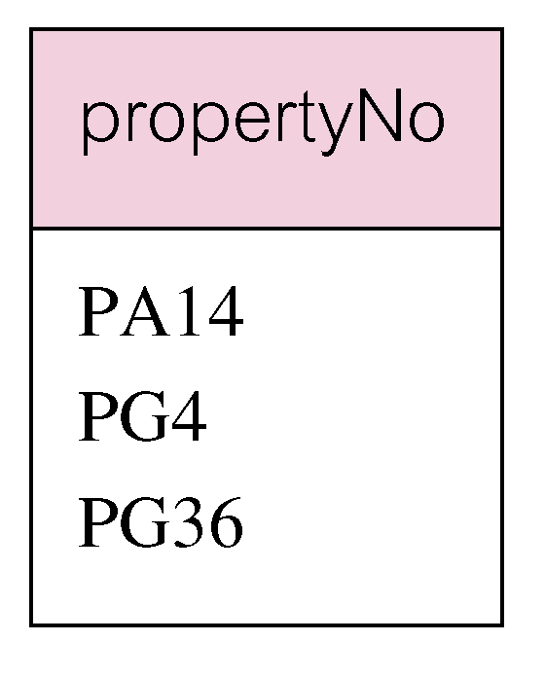
Example: Use of DISTINCT
Use DISTINCT to eliminate duplicates:
SELECT DISTINCT propertyNo
  FROM Viewing;

Slide 9
Renaming Attributes
If you want the result to have different attribute names, use “AS <new name>” to rename an attribute.
Example: Using Beers(name, manf):
SELECT name AS beer, manf
FROM Beers
WHERE manf = ’Anheuser-Busch’

Slide 10
Result of Query:
beer manf
Bud Anheuser-Busch
Bud Lite Anheuser-Busch
Michelob Anheuser-Busch
. . . . . .

Slide 11
Expressions in SELECT Clauses
Any expression that makes sense can appear as an element of a SELECT clause.
Example: Using Sells(bar, beer, price):
SELECT bar, beer,
price*114 AS priceInYen
FROM Sells;

Slide 12
Result of Query
bar beer priceInYen
Joe’s Bud 285
Sue’s Miller 342
… … …

Slide 13
Example: Constants as Expressions
Using Likes(drinker, beer):
SELECT drinker,
’likes Bud’ AS whoLikesBud
FROM Likes
WHERE beer = ’Bud’;

Slide 14
Result of Query
drinker whoLikesBud
Sally likes Bud
Fred likes Bud
… …

Slide 15
Complex Conditions in WHERE Clause
Boolean operators AND, OR, NOT.
Comparisons =, <>, <, >, <=, >=.
  And many other operators that produce boolean-valued results.

Slide 16
Example: Complex Condition
Using Sells(bar, beer, price), find the price Joe’s Bar charges for Bud:
SELECT price
FROM Sells
WHERE bar = ’Joe’’s Bar’ AND
beer = ’Bud’;
Notice how we
get a single-quote
in strings.

Slide 17
Example: Range Search Condition
◆List all staff with a salary between 20,000 and 30,000.
SELECT staffNo, fName, lName, position, salary
  FROM Staff
  WHERE salary BETWEEN 20000 AND 30000;
BETWEEN test includes the endpoints of range.

Slide 18
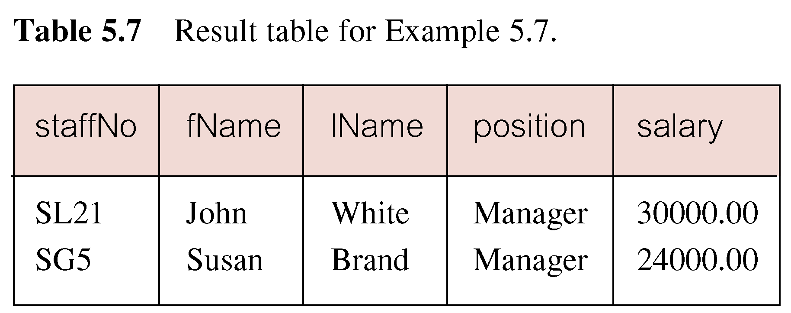
Example: Range Search Condition

Slide 19
Example:Range Search Condition
Also a negated version NOT BETWEEN.
BETWEEN does not add much to SQL’s expressive power. Could also write:
SELECT staffNo, fName, lName, position, salary
  FROM Staff
  WHERE salary>=20000 AND salary <= 30000;
Useful, though, for a range of values.

Slide 20
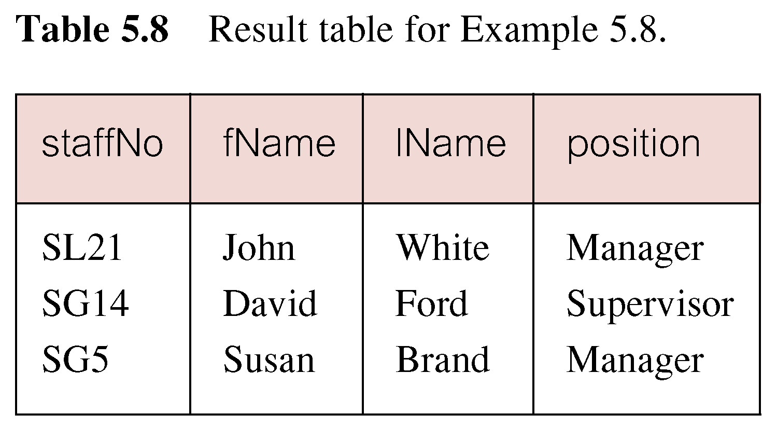
Example: Set Membership
◆List all managers and supervisors.
  SELECT staffNo, fName, lName, position
  FROM Staff
  WHERE position IN (‘Manager’, ‘Supervisor’);

Slide 21
Example: Set Membership
There is a negated version (NOT IN).
IN does not add much to SQL’s
expressive power.
Could have expressed this as:
  SELECT staffNo, fName, lName, position
  FROM Staff
  WHERE position=‘Manager’ OR
  position=‘Supervisor’;
IN is more efficient when set contains many values.

Slide 22
Patterns
WHERE clauses can have conditions in which a string is compared with a pattern, to see if it matches.
General form: <Attribute> LIKE <pattern> or <Attribute> NOT LIKE <pattern>
Pattern is a quoted string with % = “any string”; _ = “any character.”

Slide 23
Example: LIKE
Using Drinkers(name, addr, phone) find the drinkers with exchange 555:
SELECT name
FROM Drinkers
WHERE phone LIKE ’%555-_ _ _ _’;

Slide 24
LIKE syntax：
[not] like <pattern>[ESCAPE ‘transfer character’]
example：
Select cno From course
Where cname like ‘DB\_DESIGN’ ESCAPE ‘\’;
Example:
Select * From course
Where cname like ‘DB\_%i__’ ESCAPE ‘\’;
note：\ 后面的 _ 不具有通配符含义

Slide 25
Example: NULL Search Condition
List details of all viewings on property PG4 where a comment has not been supplied.
Have to test for null explicitly using special keyword IS NULL:
SELECT clientNo, viewDate
  FROM Viewing
  WHERE propertyNo = ‘PG4’ AND
  comment IS NULL;
  ◆Negated version (IS NOT NULL) can test for non-null values.

Slide 26
Example : Single Column Ordering
◆List salaries for all staff, arranged in descending order of salary.
SELECT staffNo, fName, lName, salary
  FROM Staff
  ORDER BY salary DESC;

Slide 27
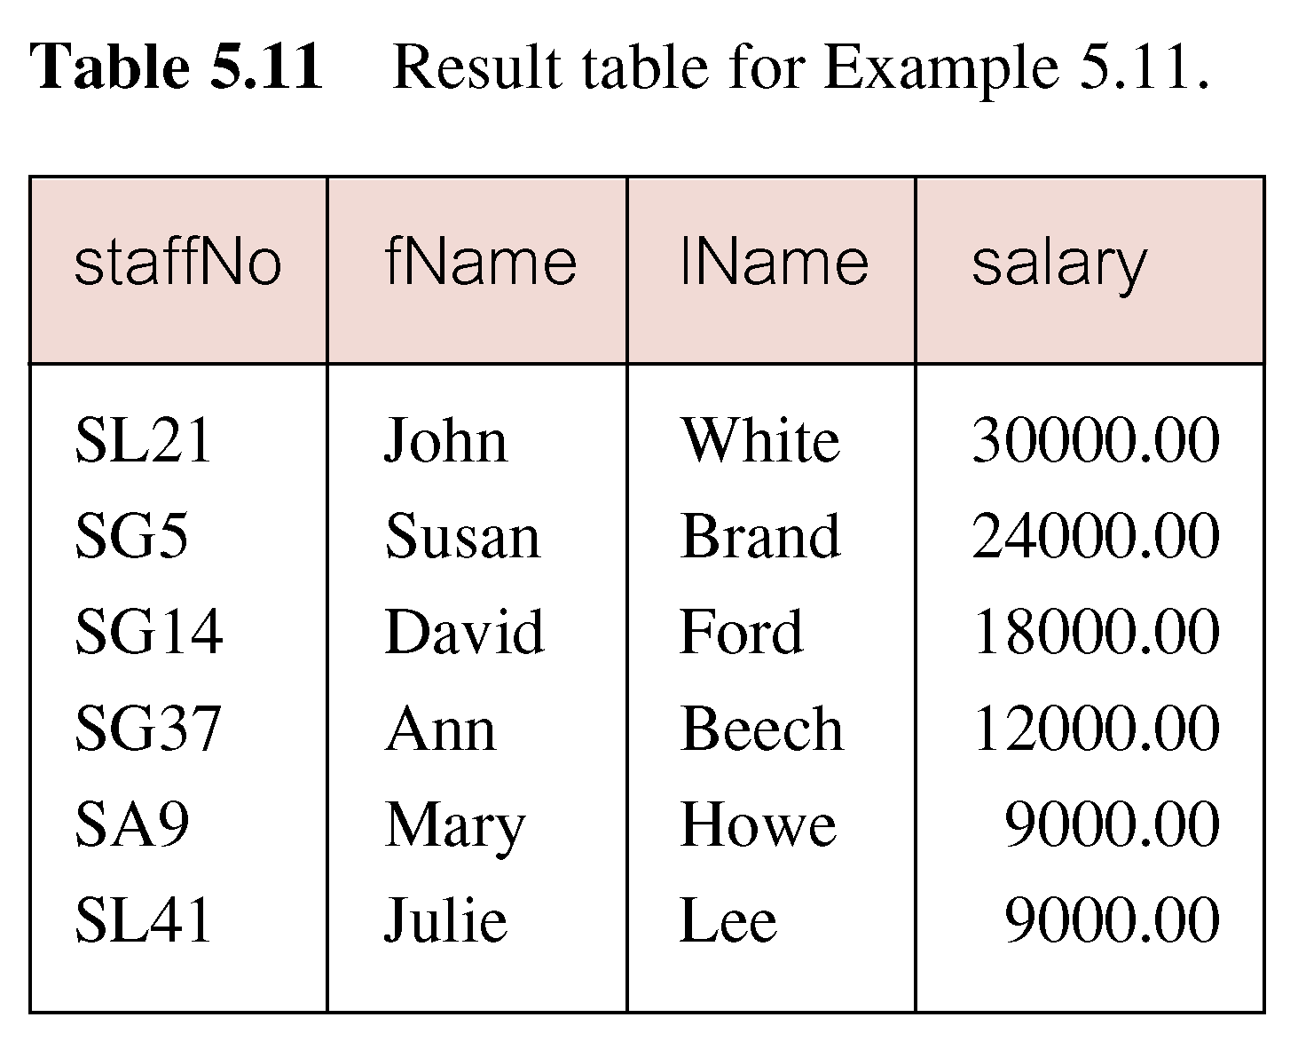
Example : Single Column Ordering

Slide 28
Example :Multiple Column Ordering
◆Produce abbreviated list of
properties in order of property type.
SELECT propertyNo, type, rooms, rent
  FROM PropertyForRent
  ORDER BY type;

Slide 29
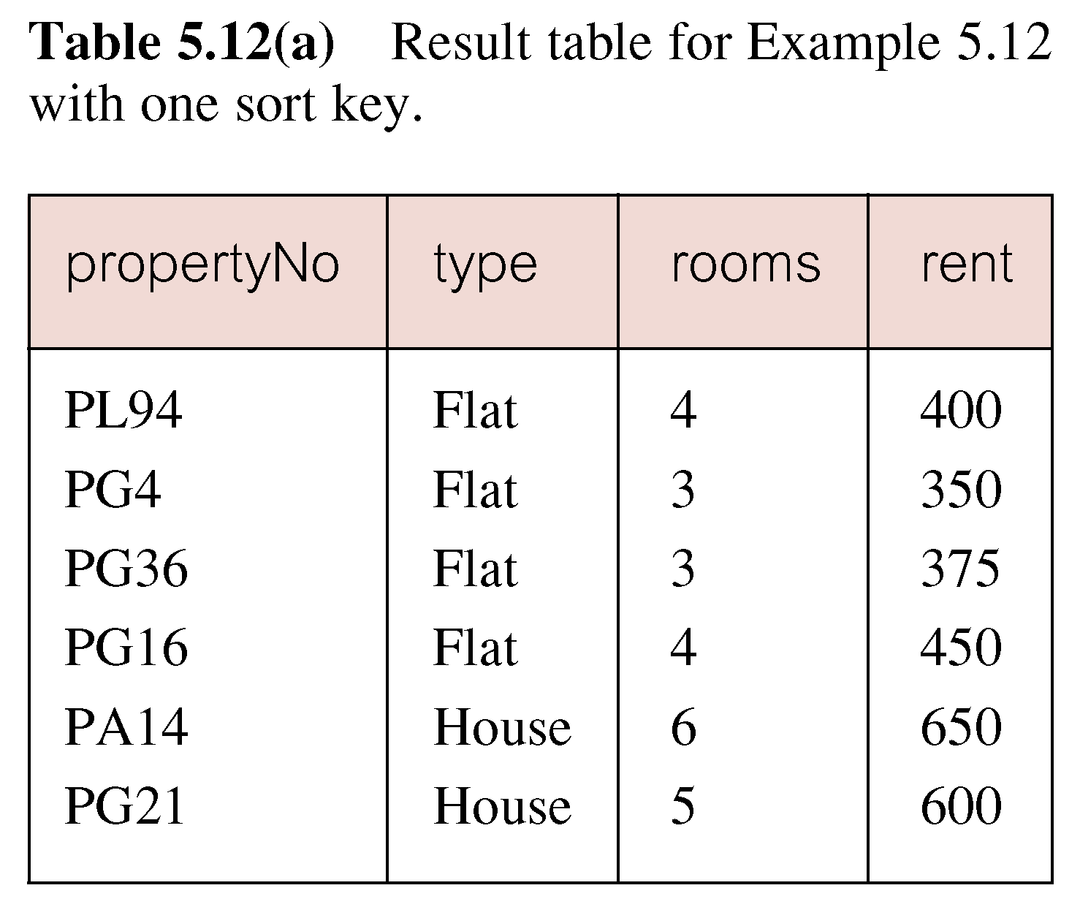
Example : Multiple Column Ordering

Slide 30
Example : Multiple Column Ordering
Four flats in this list - as no minor sort key specified, system arranges these rows in any order it chooses.
To arrange in order of rent, specify minor order:
SELECT propertyNo, type, rooms, rent
  FROM PropertyForRent
  ORDER BY type, rent DESC;

Slide 31
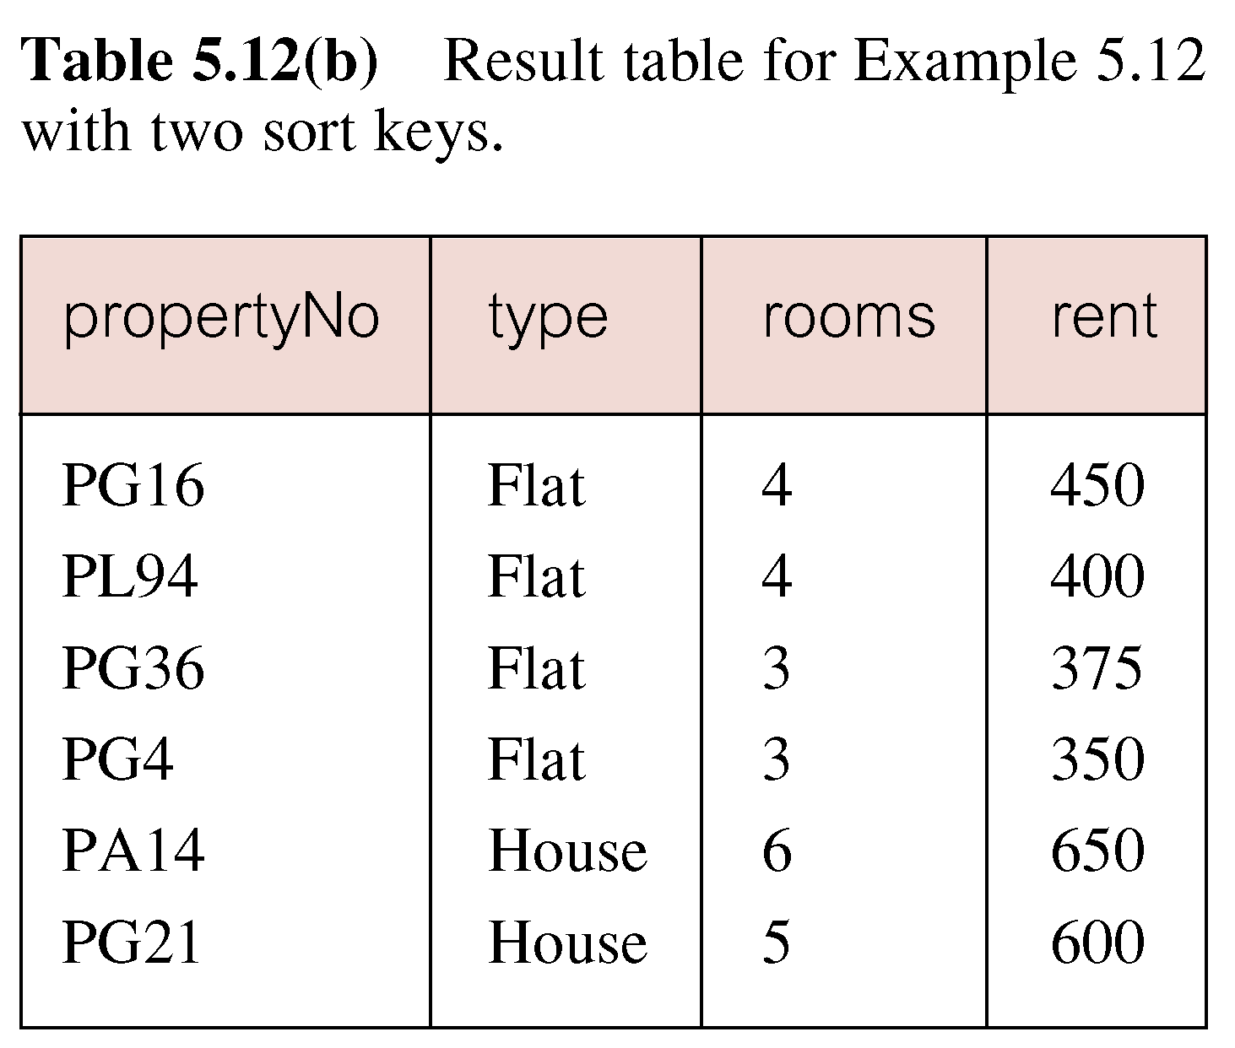
Example : Multiple Column Ordering

Slide 32
SELECT Statement - Aggregates
ISO standard defines five aggregate functions:
COUNT returns number of values in specified column.
SUM returns sum of values in specified column.
AVG returns average of values in specified column.
MIN returns smallest value in specified column.
MAX returns largest value in specified column.

Slide 33
SELECT Statement - Aggregates
Each operates on a single column of a table and returns a single value.
COUNT, MIN, and MAX apply to numeric and non-numeric fields, but SUM and AVG may be used on numeric fields only.
Apart from COUNT(*), each function eliminates nulls first and operates only on remaining non-null values.

Slide 34
SELECT Statement - Aggregates
COUNT(*) counts all rows of a table, regardless of whether nulls or duplicate values occur.
Can use DISTINCT before column name to eliminate duplicates.
DISTINCT has no effect with MIN/MAX, but may have with SUM/AVG.

Slide 35
SELECT Statement - Aggregates
Aggregate functions can be used only in SELECT list and in HAVING clause.
If SELECT list includes an aggregate function and there is no GROUP BY clause, SELECT list cannot reference a column out with an aggregate function.
For example, the following is illegal:
SELECT staffNo, COUNT(salary)
  FROM Staff;

Slide 36
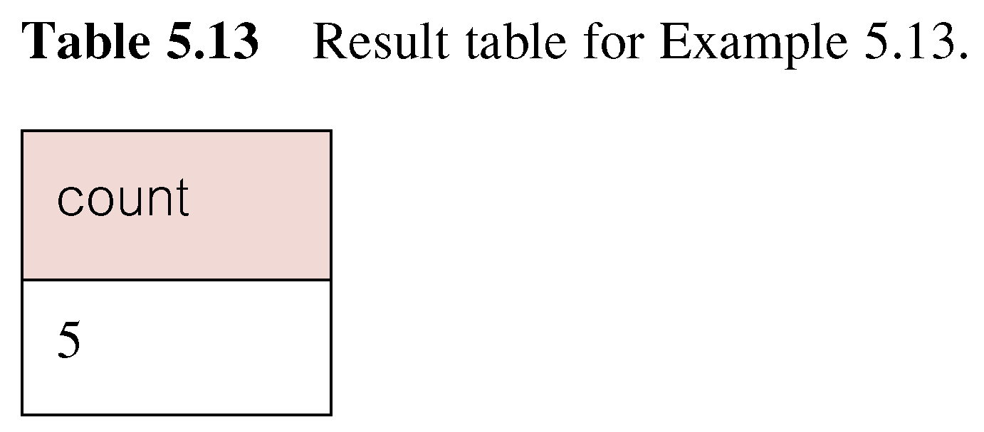
Example : Use of COUNT(*)
◆How many properties cost more than £350 per month to rent?
SELECT COUNT(*) AS count
  FROM PropertyForRent
  WHERE rent > 350;

Slide 37
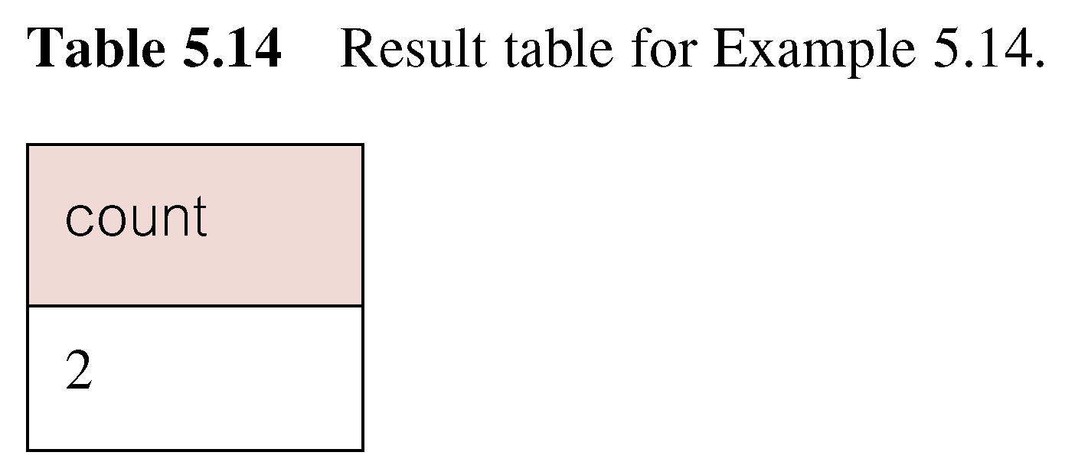
Example: Use of COUNT(DISTINCT)
◆How many different properties viewed in May?
SELECT COUNT(DISTINCT propertyNo) AS count
  FROM Viewing
  WHERE viewDate BETWEEN ‘1-May-01’
  AND ‘31-May-01’;

Slide 38
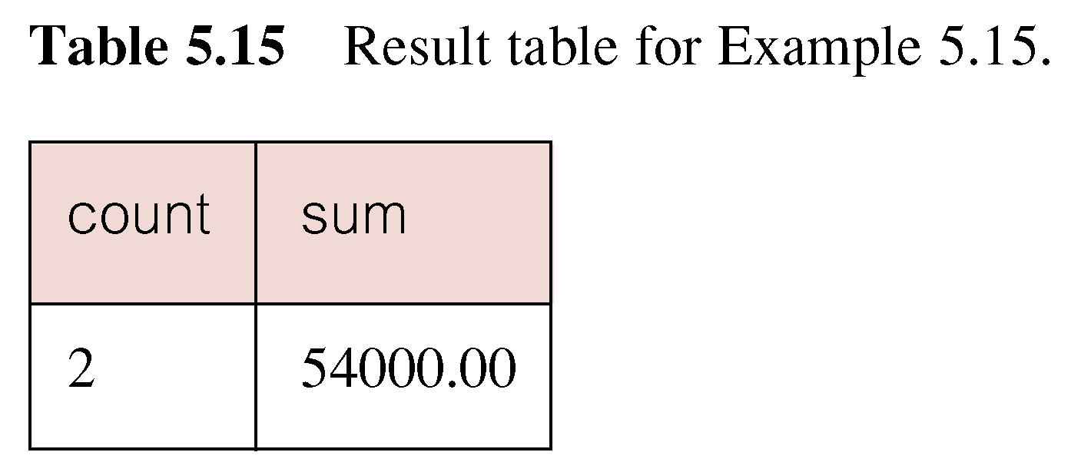
Example : Use of COUNT and SUM
◆Find number of Managers and sum of their salaries.
SELECT COUNT(staffNo) AS count,
  SUM(salary) AS sum
  FROM Staff
  WHERE position = ‘Manager’;

Slide 39
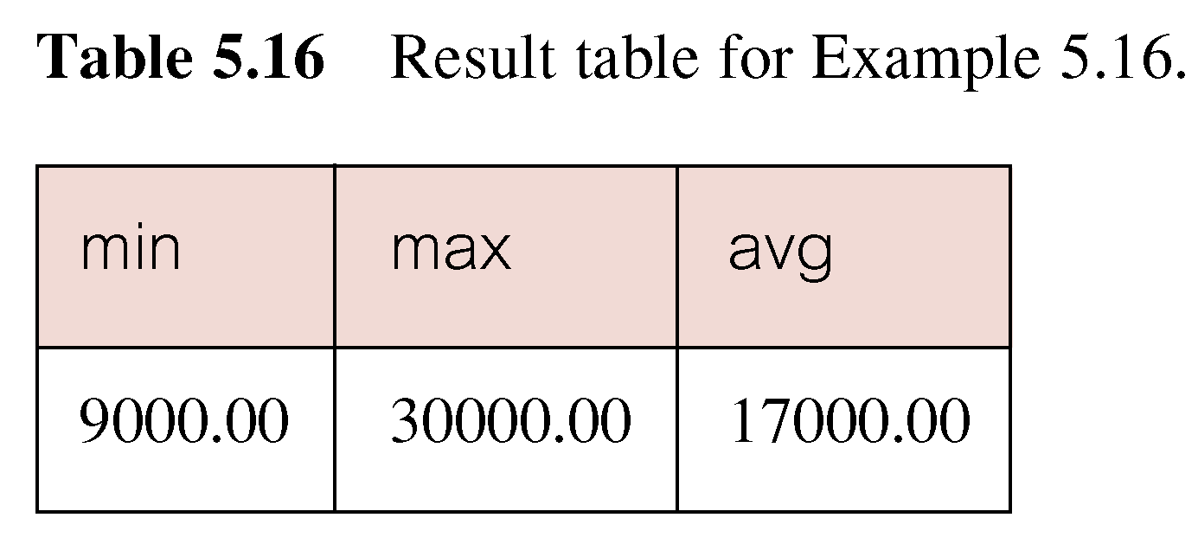
Example : Use of MIN, MAX, AVG
◆Find minimum, maximum, and average staff salary.
SELECT MIN(salary) AS min,
  MAX(salary) AS max,
  AVG(salary) AS avg
  FROM Staff;

Slide 40
SELECT Statement - Grouping
Use GROUP BY clause to get sub-totals.
SELECT and GROUP BY closely integrated: each item in SELECT list must be single-valued per group, and SELECT clause may only contain:
  column names
  aggregate functions
  constants
  expression involving combinations of the above.

Slide 41
SELECT Statement - Grouping
All column names in SELECT list must appear in GROUP BY clause unless name is used only in an aggregate function.
If WHERE is used with GROUP BY, WHERE is applied first, then groups are formed from remaining rows satisfying predicate.
ISO considers two nulls to be equal for purposes of GROUP BY.

Slide 42
Example : Use of GROUP BY
◆Find number of staff in each branch and their total salaries.
  SELECT branchNo,
  COUNT(staffNo) AS count,
    SUM(salary) AS sum
    FROM Staff
    GROUP BY branchNo
    ORDER BY branchNo;

Slide 43
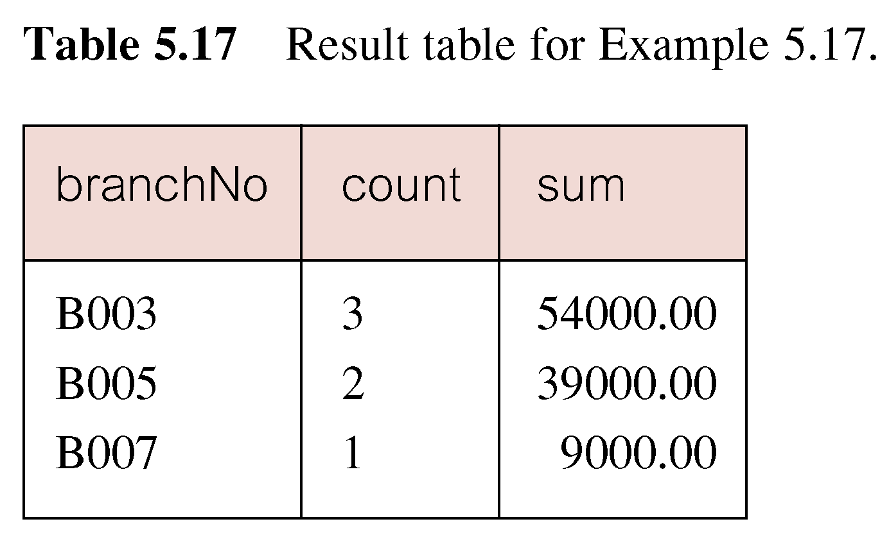
Example : Use of GROUP BY

Slide 44
Restricted Groupings – HAVING clause
HAVING clause is designed for use with GROUP BY to restrict groups that appear in final result table.
Similar to WHERE, but WHERE filters individual rows whereas HAVING filters groups.
Column names in HAVING clause must also appear in the GROUP BY list or be contained within an aggregate function.

Slide 45
Example : Use of HAVING
◆For each branch with more than 1 member of staff, find number of staff in each branch and sum of their salaries.
  SELECT branchNo,
  COUNT(staffNo) AS count,
    SUM(salary) AS sum
    FROM Staff
    GROUP BY branchNo
    HAVING COUNT(staffNo) > 1
    ORDER BY branchNo;

Slide 46
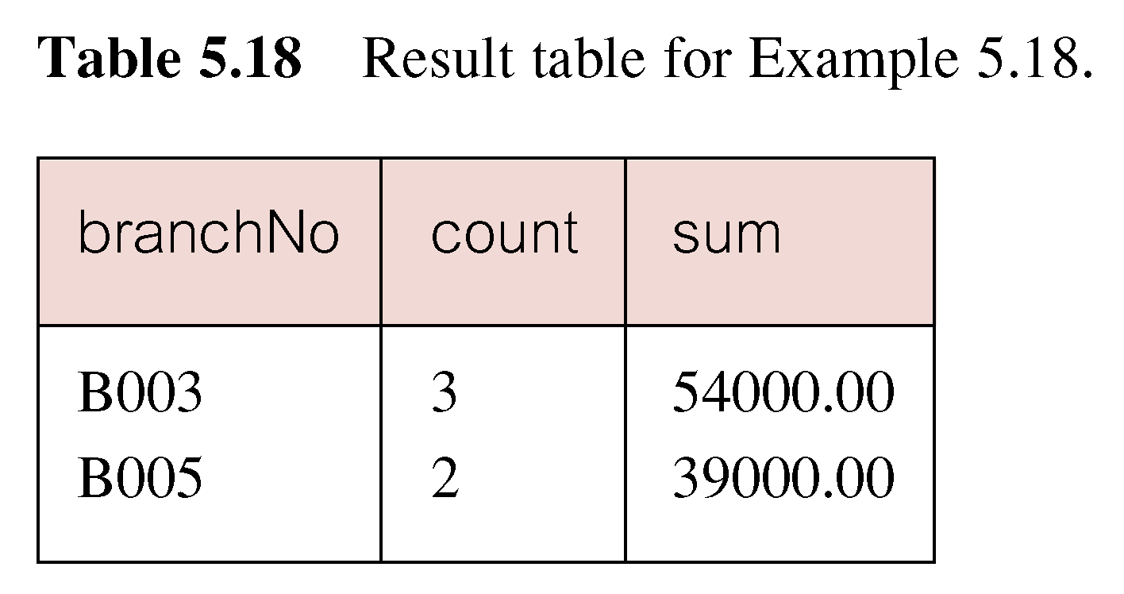
Example : Use of HAVING

Slide 47
Example: HAVING
From Sells(bar, beer, price) and Beers(name, manf), find the average price of those beers that are either served in at least three bars or are manufactured by Pete’s.

Slide 48
Solution
Beer groups with at least
3 non-NULL bars and also
beer groups where the
manufacturer is Pete’s.
SELECT beer, AVG(price)
FROM Sells
GROUP BY beer
HAVING COUNT(bar) >= 3 OR
beer IN (SELECT name
FROM Beers
WHERE manf = ’Pete’’s’);
Beers manu-
factured by
Pete’s.

Slide 49
Subqueries
Some SQL statements can have a SELECT embedded within them.
A subselect can be used in WHERE and HAVING clauses of an outer SELECT, where it is called a subquery or nested query.
Subselects may also appear in INSERT, UPDATE, and DELETE statements.

Slide 50
Type of subquery
A scalar subquery: return a single column and a single row
A row subquery: return multiple columns ,but only a single row
A table subquery: return one or more columns and multiple rows
Correlation subquery:
Uncorrelation subquery:

Slide 51
Example : Subquery with Equality
◆List staff who work in branch at ‘163 Main St’.
SELECT staffNo, fName, lName, position
  FROM Staff
  WHERE branchNo =
  (SELECT branchNo
  FROM Branch
  WHERE street = ‘163 Main St’);

Slide 52
Example :Subquery with Equality
Inner SELECT finds branch number for branch at ‘163 Main St’ (‘B003’).
Outer SELECT then retrieves details of all staff who work at this branch.
Outer SELECT then becomes:
  SELECT staffNo, fName, lName, position
    FROM Staff
    WHERE branchNo = ‘B003’;

Slide 53
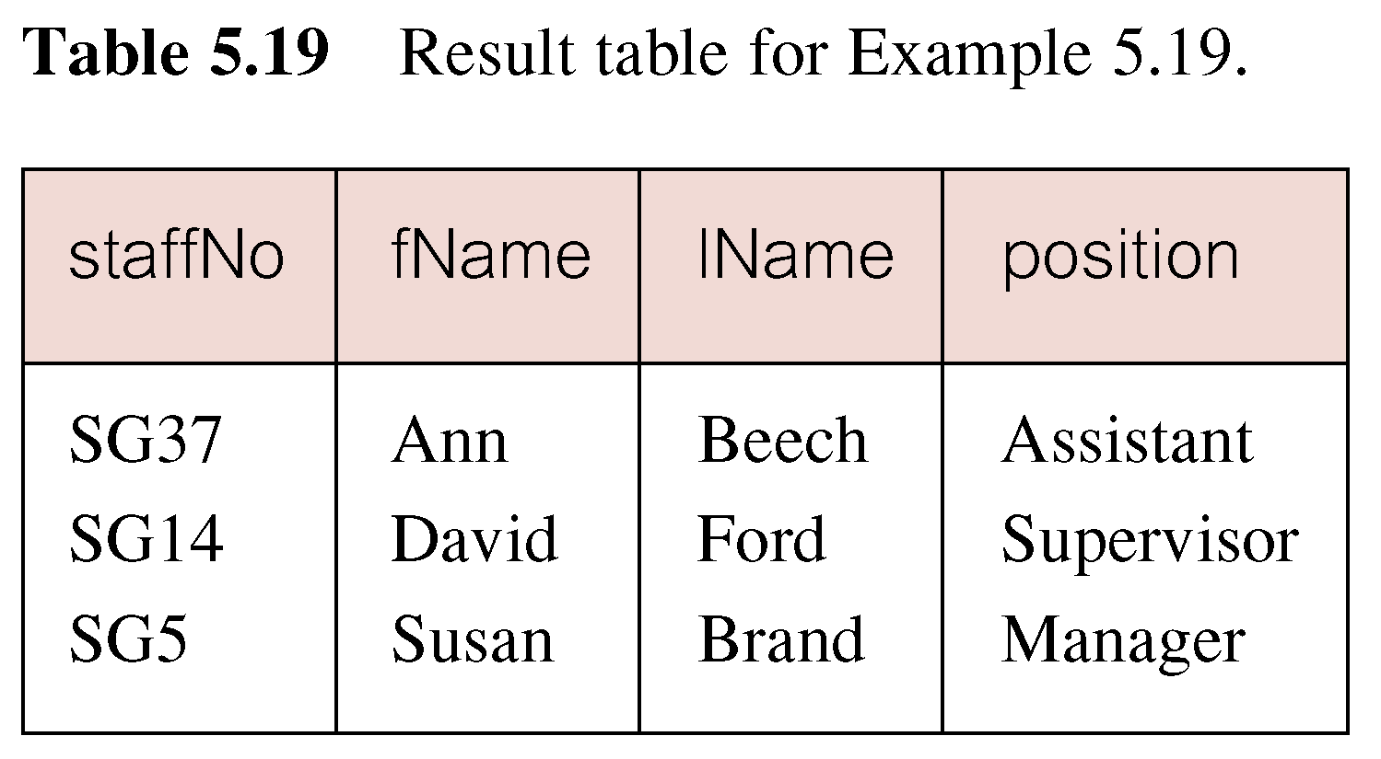
Example : Subquery with Equality

Slide 54
Example :Subquery with Aggregate
◆List all staff whose salary is greater than the average salary, and show by how much.
  SELECT staffNo, fName, lName, position,
  salary – (SELECT AVG(salary) FROM Staff) As SalDiff
  FROM Staff
  WHERE salary >
    (SELECT AVG(salary)
    FROM Staff);

Slide 55
Example : Subquery with Aggregate
Cannot write ‘WHERE salary > AVG(salary)’
Instead, use subquery to find average salary (17000), and then use outer SELECT to find those staff with salary greater than this:
  SELECT staffNo, fName, lName, position,
  salary – 17000 As salDiff
  FROM Staff
  WHERE salary > 17000;

Slide 56
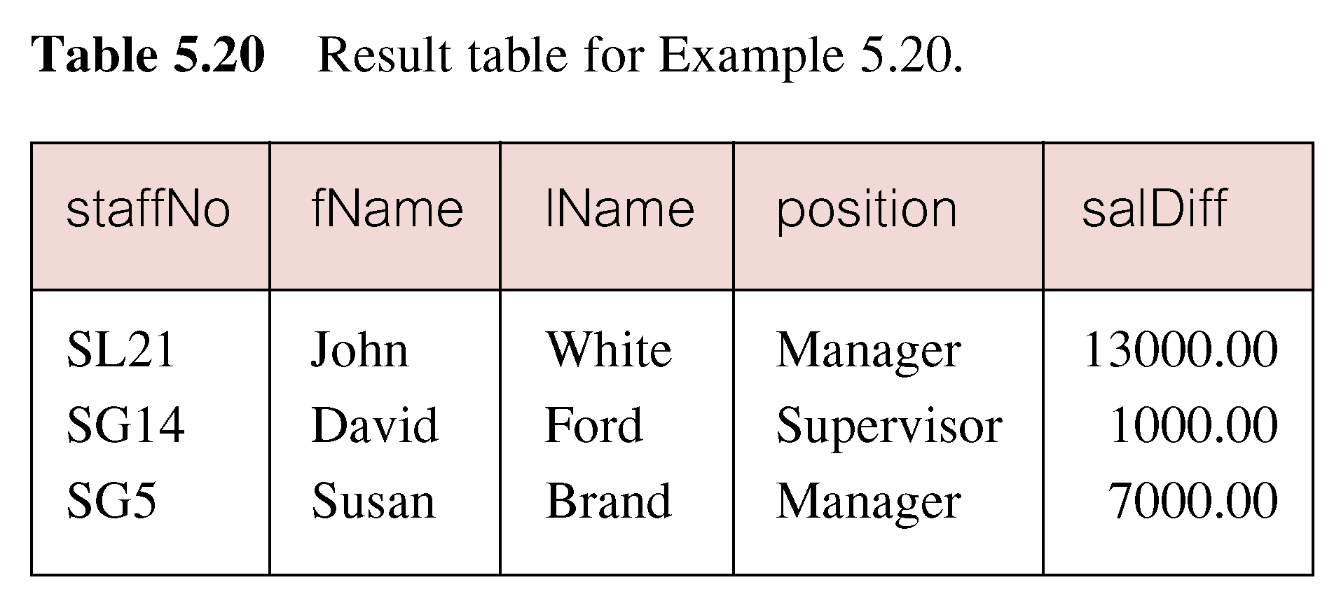
Example : Subquery with Aggregate

Slide 57
Subquery Rules
ORDER BY clause may not be used in a subquery (although it may be used in outermost SELECT).
Subquery SELECT list must consist of a single column name or expression, except for subqueries that use EXISTS.
By default, column names refer to table name in FROM clause of subquery. Can refer to a table in FROM using an alias.

Slide 58
Subquery Rules
When subquery is an operand in a comparison, subquery must appear on right-hand side.
A subquery may be used as an operand in an expression.

Slide 59
Subqueries
A parenthesized SELECT-FROM-WHERE statement (subquery ) can be used as a value in a number of places, including FROM and WHERE clauses.
Example: in place of a relation in the FROM clause, we can use a subquery and then query its result.
  Must use a tuple-variable to name tuples of the result.

Slide 60
Example: Subquery in FROM
Find the beers liked by at least one person who frequents Joe’s Bar.
SELECT beer
FROM Likes, (SELECT drinker
FROM Frequents
WHERE bar = ’Joe’’s Bar’)JD
WHERE Likes.drinker = JD.drinker;
Drinkers who
frequent Joe’s Bar

Slide 61
Example: Single-Tuple Subquery
Using Sells(bar, beer, price), find the bars that serve Miller for the same price Joe charges for Bud.
Two queries would surely work:
  Find the price Joe charges for Bud.
  Find the bars that serve Miller at that price.

Slide 62
Query + Subquery Solution
SELECT bar
FROM Sells
WHERE beer = ’Miller’ AND
price = (SELECT price
FROM Sells
WHERE bar = ’Joe’’s Bar’
AND beer = ’Bud’);
The price at
which Joe
sells Bud

Slide 63
The IN Operator
<tuple> IN <relation> is true if and only if the tuple is a member of the relation.
  <tuple> NOT IN <relation> means the opposite.
IN-expressions can appear in WHERE clauses.
The <relation> is often a subquery.

Slide 64
Example: IN
Using Beers(name, manf) and Likes(drinker, beer), find the name and manufacturer of each beer that Fred likes.
SELECT *
FROM Beers
WHERE name IN (SELECT beer
FROM Likes
WHERE drinker = ’Fred’);
The set of
beers Fred
likes

Slide 65
Example :Nested subquery: use of IN
◆List properties handled by staff at ‘163 Main St’.
  SELECT propertyNo, street, city, postcode, type, rooms, rent
  FROM PropertyForRent
  WHERE staffNo IN
    (SELECT staffNo
    FROM Staff
    WHERE branchNo =
    (SELECT branchNo
    FROM Branch
    WHERE street = ‘163 Main St’));

Slide 66
The Exists Operator
EXISTS(<subquery>) is true if and only if the subquery result is not empty.
Example: From Beers(name, manf) , find those beers that are the unique beer by their manufacturer.

Slide 67
Example: EXISTS
SELECT name
FROM Beers b1
WHERE NOT EXISTS (
SELECT *
FROM Beers
WHERE manf = b1.manf AND
name <> b1.name);
Notice scope rule: manf refers
to closest nested FROM with
a relation having that attribute.
Set of
beers
with the
same
manf as
b1, but
not the
same
beer
Notice the
SQL “not
equals”
operator

Slide 68
EXISTS and NOT EXISTS
EXISTS and NOT EXISTS are for use only with subqueries.
Produce a simple true/false result.
True if and only if there exists at least one row in result table returned by subquery.
False if subquery returns an empty result table.
NOT EXISTS is the opposite of EXISTS.

Slide 69
EXISTS and NOT EXISTS
As (NOT) EXISTS check only for existence or non-existence of rows in subquery result table, subquery can contain any number of columns.
Common for subqueries following (NOT) EXISTS to be of form:
  (SELECT * ...)

Slide 70
Example: Query using EXISTS
◆Find all staff who work in a London branch.
SELECT staffNo, fName, lName, position
  FROM Staff s
  WHERE EXISTS
  (SELECT *
  FROM Branch b
  WHERE s.branchNo = b.branchNo AND
  city = ‘London’);

Slide 71
Example: Query using EXISTS
Could also write this query using join construct:
  SELECT staffNo, fName, lName, position
  FROM Staff s, Branch b
  WHERE s.branchNo = b.branchNo AND
  city = ‘London’;

Slide 72
The Operator ANY
x = ANY(<subquery>) is a boolean condition that is true if x equals at least one tuple in the subquery result.
  = could be any comparison operator.
Example: x >= ANY(<subquery>) means x is not the uniquely smallest tuple produced by the subquery.
  Note tuples must have one component only.

Slide 73
The Operator ALL
x <> ALL(<subquery>) is true if for every tuple t in the relation, x is not equal to t.
  That is, x is not in the subquery result.
<> can be any comparison operator.
Example: x >= ALL(<subquery>) means there is no tuple larger than x in the subquery result.

Slide 74
Example: ALL
From Sells(bar, beer, price), find the beer(s) sold for the highest price.
SELECT beer
FROM Sells
WHERE price >= ALL(
SELECT price
FROM Sells);
price from the outer
Sells must not be
less than any price.

Slide 75
ANY and ALL
ANY and ALL may be used with subqueries that produce a single column of numbers.
With ALL, condition will only be true if it is satisfied by all values produced by subquery.
With ANY, condition will be true if it is satisfied by any values produced by subquery.
If subquery is empty, ALL returns true, ANY returns false.
SOME may be used in place of ANY.

Slide 76
Example: Use of ANY/SOME
◆Find staff whose salary is larger than salary of at least one member of staff at branch B003.
SELECT staffNo, fName, lName, position, salary
  FROM Staff
  WHERE salary > SOME
  (SELECT salary
  FROM Staff
  WHERE branchNo = ‘B003’);

Slide 77
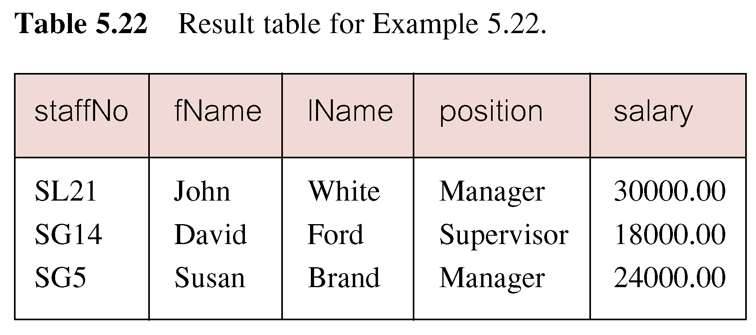
Example :Use of ANY/SOME
Inner query produces set {12000, 18000, 24000} and outer query selects those staff whose salaries are greater than any of the values in this set.

Slide 78
Example :Use of ALL
◆Find staff whose salary is larger than salary of every member of staff at branch B003.
SELECT staffNo, fName, lName, position, salary
  FROM Staff
  WHERE salary > ALL
  (SELECT salary
  FROM Staff
  WHERE branchNo = ‘B003’);

Slide 79
Compare ANY/ALL with Aggregate Function
 | ANY | ALL
= | IN | No meaning
<> | No meaning | NOT IN
< | < MAX | < MIN
<= | <= MAX | <= MIN
> | > MIN | > MAX
>= | >= MIN | >= MAX

Slide 80
Union, Intersection, and Difference
Union, intersection, and difference of relations are expressed by the following forms, each involving subqueries:
  (<subquery>) UNION (<subquery>)
  (<subquery>) INTERSECT (<subquery>)
  (<subquery>) EXCEPT (<subquery>)
◆Two subquery must be union compatible.

Slide 81
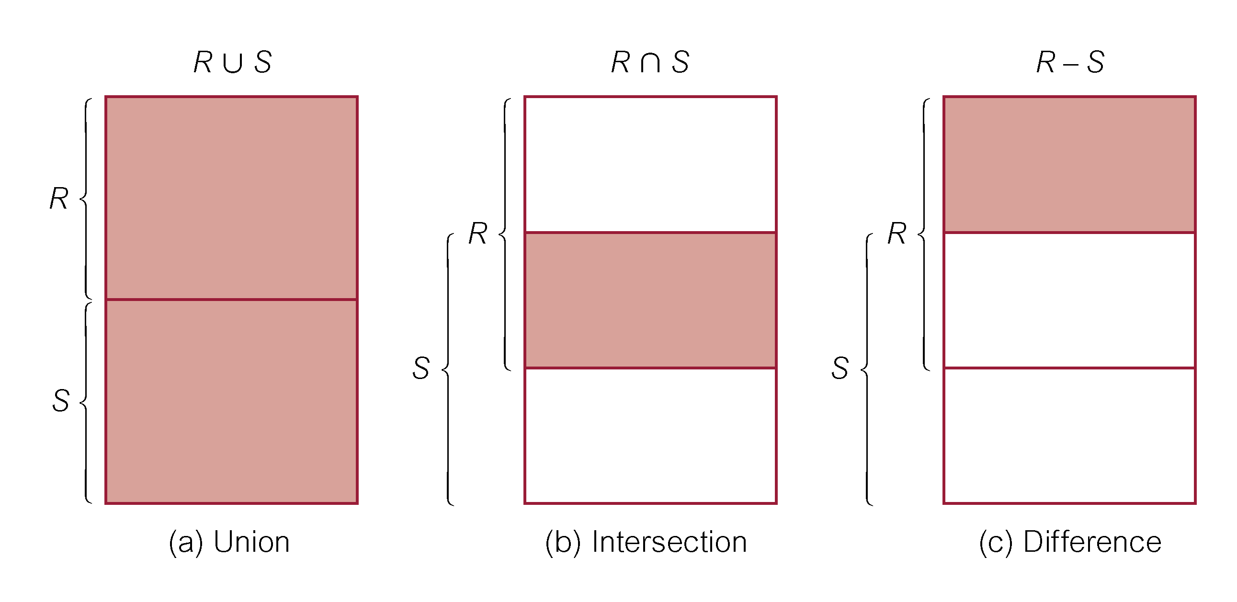
Union, Intersect, and Difference (Except)

Slide 82
Example : Use of UNION
◆List all cities where there is either a branch office or a property.
(SELECT city
  FROM Branch
  WHERE city IS NOT NULL)
  UNION
  (SELECT city
  FROM PropertyForRent
  WHERE city IS NOT NULL);

Slide 83
Example : Use of INTERSECT
◆List all cities where there is both a branch office and a property.
(SELECT city FROM Branch)
  INTERSECT
  (SELECT city FROM PropertyForRent);

Slide 84
Example : Use of INTERSECT
Could rewrite this query without INTERSECT operator:
  SELECT b.city
  FROM Branch b ,PropertyForRent p
  WHERE b.city = p.city;
Or:
  SELECT DISTINCT city FROM Branch b
  WHERE EXISTS
  (SELECT * FROM PropertyForRent p
  WHERE p.city = b.city);

Slide 85
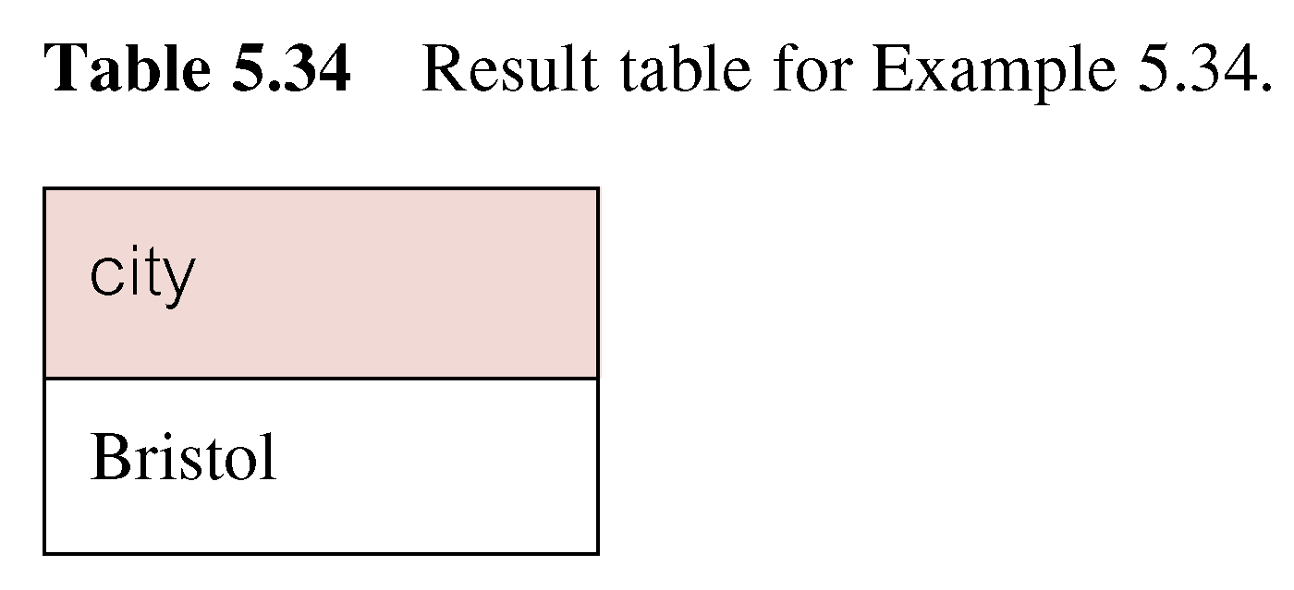
Example : Use of EXCEPT
◆List of all cities where there is a branch office but no properties.
(SELECT city FROM Branch)
  EXCEPT
  (SELECT city FROM PropertyForRent);

Slide 86
Example: Use of EXCEPT
Could rewrite this query without EXCEPT:
  SELECT DISTINCT city FROM Branch
  WHERE city NOT IN
  (SELECT city FROM PropertyForRent);
Or
  SELECT DISTINCT city FROM Branch b
  WHERE NOT EXISTS
  (SELECT * FROM PropertyForRent p
  WHERE p.city = b.city);

Slide 87
Multi-Table Queries
Can use subqueries provided result columns come from same table.
If result columns come from more than one table must use a join.
To perform join, include more than one table in FROM clause.
Use comma as separator and typically include WHERE clause to specify join column(s).

Slide 88
Multi-Table Queries
Also possible to use an alias for a table named in FROM clause.
Alias is separated from table name with a space.
Alias can be used to qualify column names when there is ambiguity.

Slide 89
Example: Self-Join
From Beers(name, manf), find all pairs of beers by the same manufacturer.
  Do not produce pairs like (Bud, Bud).
  Produce pairs in alphabetic order, e.g. (Bud, Miller), not (Miller, Bud).
SELECT b1.name, b2.name
FROM Beers b1, Beers b2
WHERE b1.manf = b2.manf AND
b1.name < b2.name;

Slide 90
Example : Simple Join
◆List names of all clients who have viewed a property along with any comment supplied.
SELECT c.clientNo, fName, lName,
  propertyNo, comment
  FROM Client c, Viewing v
  WHERE c.clientNo = v.clientNo;

Slide 91
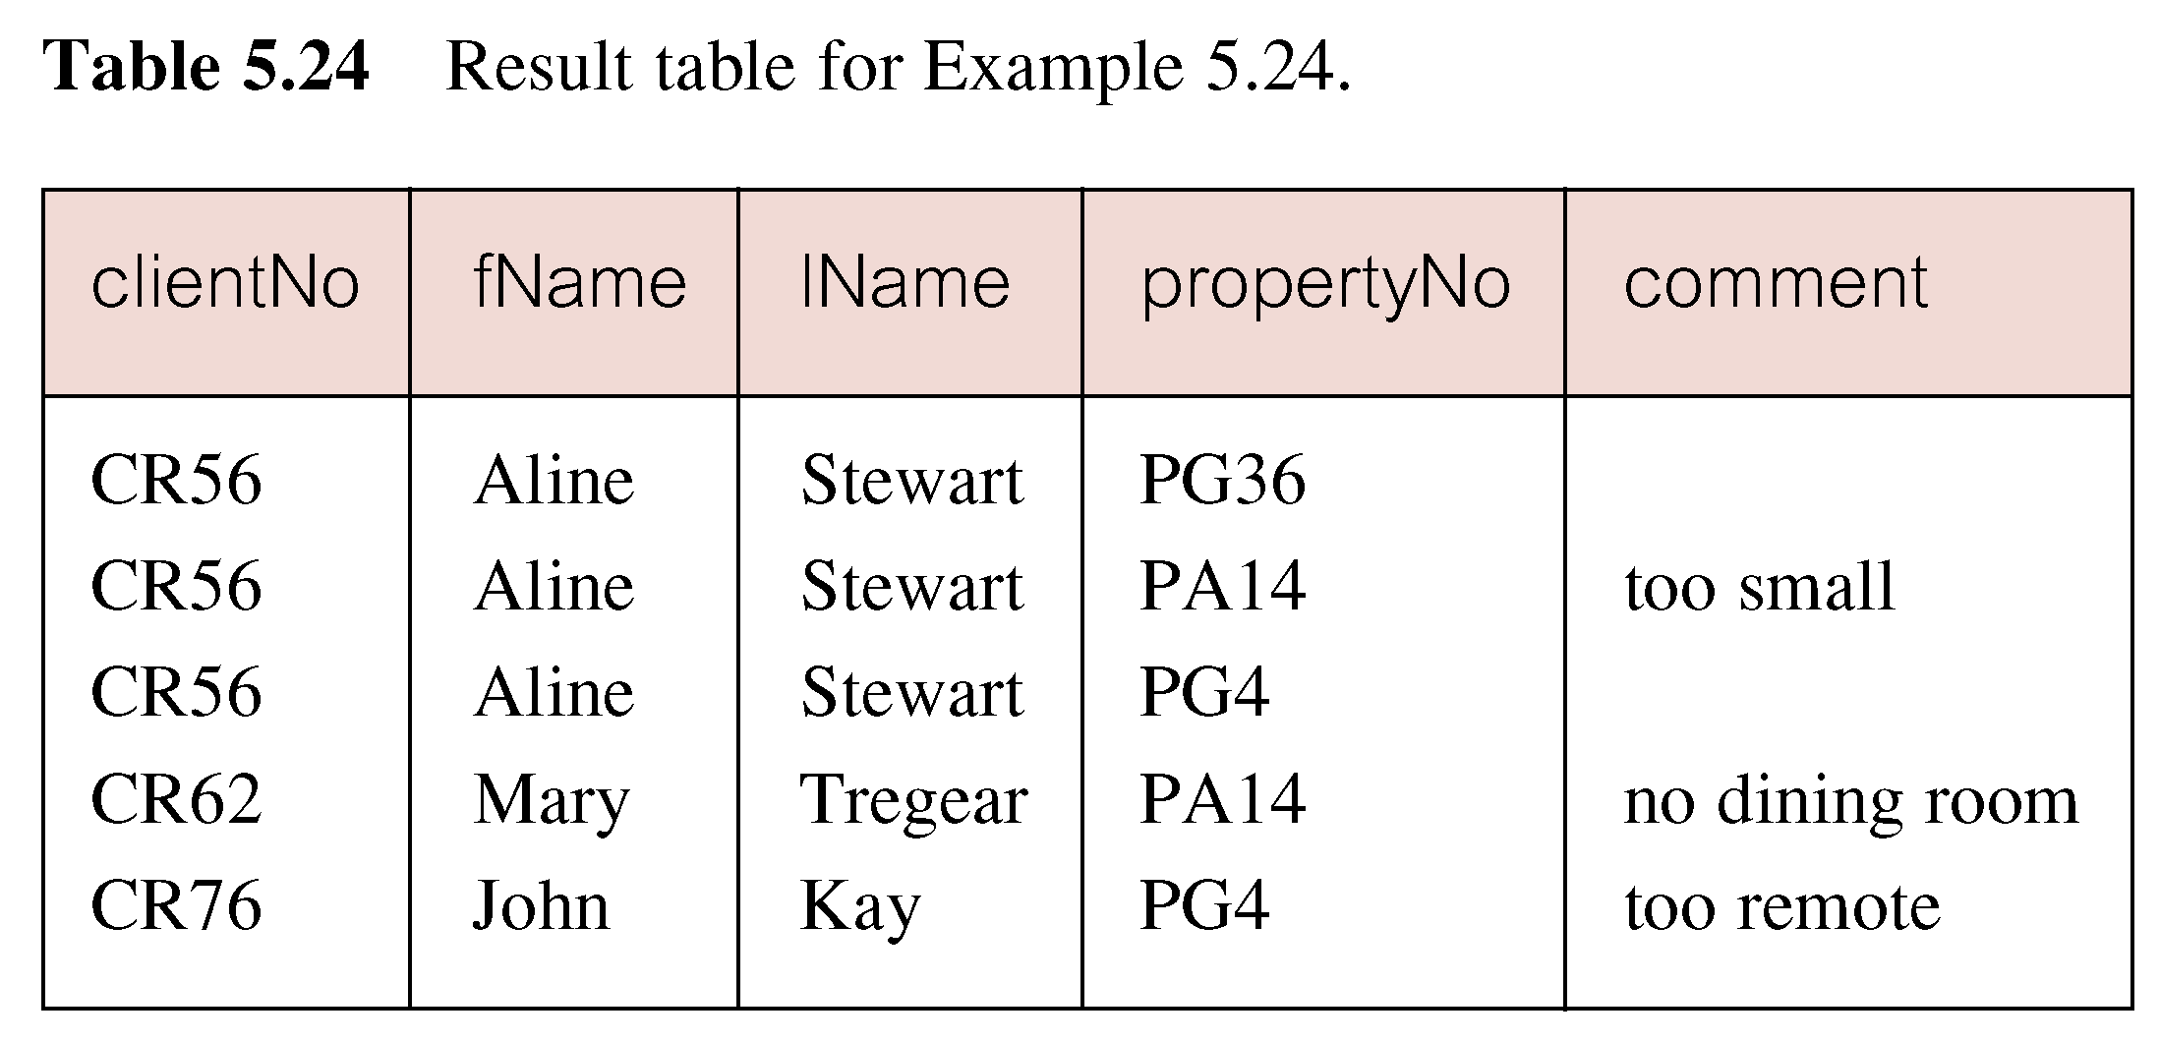
Example : Simple Join
Only those rows from both tables that have identical values in the clientNo columns (c.clientNo = v.clientNo) are included in result.
Equivalent to equi-join in relational
algebra.

Slide 92
Alternative JOIN Constructs
SQL provides alternative ways to specify joins:
FROM Client c JOIN Viewing v
ON c.clientNo = v.clientNo
FROM Client JOIN Viewing USING （clientNo）
FROM Client NATURAL JOIN Viewing
In each case, FROM replaces original FROM and WHERE. However, first produces table with two identical clientNo columns.

Slide 93
Example : Sorting a join
◆For each branch, list numbers and names of staff who manage properties, and properties they manage.
SELECT s.branchNo, s.staffNo,
fName, lName, propertyNo
  FROM Staff s, PropertyForRent p
  WHERE s.staffNo = p.staffNo
  ORDER BY s.branchNo, s.staffNo,
  propertyNo;

Slide 94
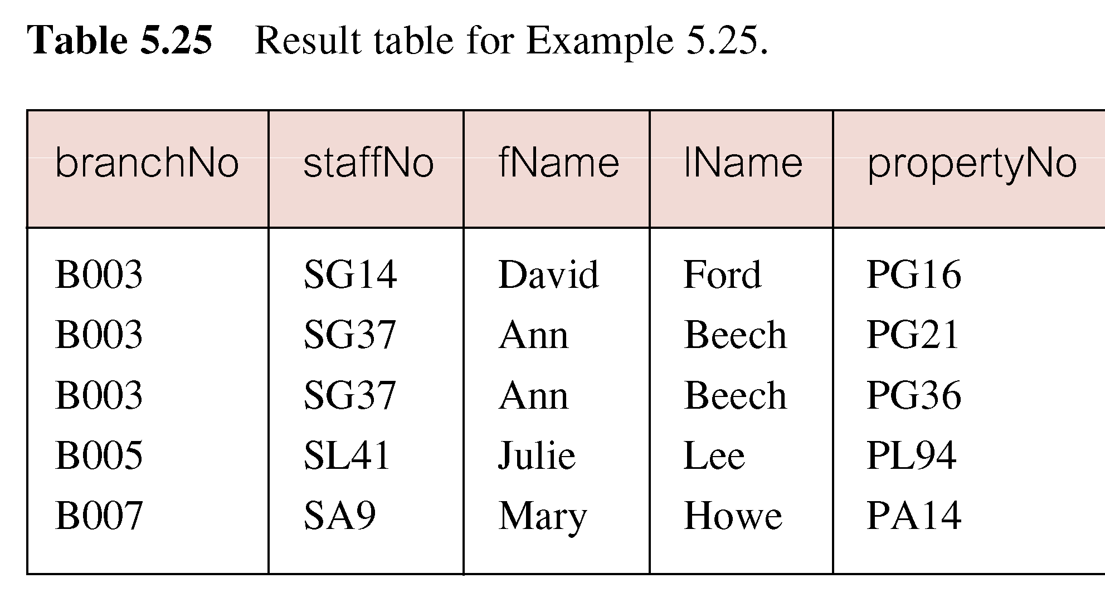
Example : Sorting a join

Slide 95
Example : Three Table Join
◆For each branch, list staff who manage properties, including city in which branch is located and properties they manage.
SELECT b.branchNo, b.city, s.staffNo,
fName, lName, propertyNo
  FROM Branch b, Staff s, PropertyForRent p
  WHERE b.branchNo = s.branchNo AND
  s.staffNo = p.staffNo
  ORDER BY b.branchNo, s.staffNo,
  propertyNo;

Slide 96
Example : Three Table Join
Alternative formulation for FROM and WHERE:
  FROM (Branch b JOIN Staff s USING (branchNo))
  AS bs JOIN PropertyForRent p USING (staffNo)

Slide 97
Example :Multiple Grouping Columns
◆Find number of properties handled by each staff member.
SELECT s.branchNo, s.staffNo,
COUNT(*) AS count
  FROM Staff s, PropertyForRent p
  WHERE s.staffNo = p.staffNo
  GROUP BY s.branchNo, s.staffNo
  ORDER BY s.branchNo, s.staffNo;

Slide 98
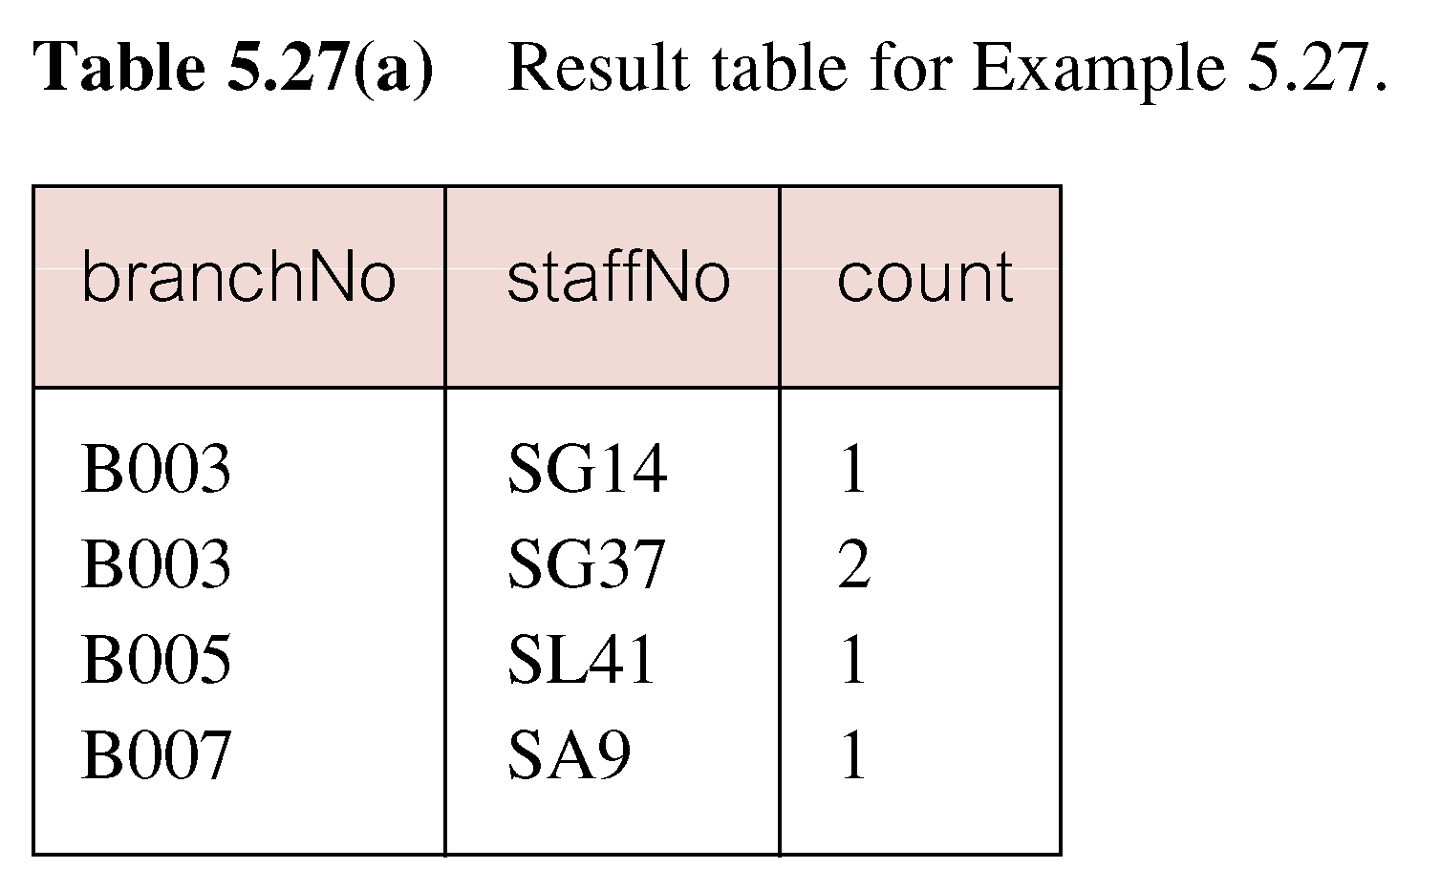
Example : Multiple Grouping Columns

Slide 99
Computing a Join
◆Procedure for generating results of a join are:
1. Form Cartesian product of the tables named in FROM clause.
2. If there is a WHERE clause, apply the search condition to each row of the product table, retaining those rows that satisfy the condition.
3. For each remaining row, determine value of each item in SELECT list to produce a single row in result table.

Slide 100
Computing a Join
4. If DISTINCT has been specified, eliminate any duplicate rows from the result table.
5. If there is an ORDER BY clause, sort result table as required.
SQL provides special format of SELECT for Cartesian product:
  SELECT [DISTINCT | ALL] {* | columnList}
  FROM Table1 CROSS JOIN Table2

Slide 101
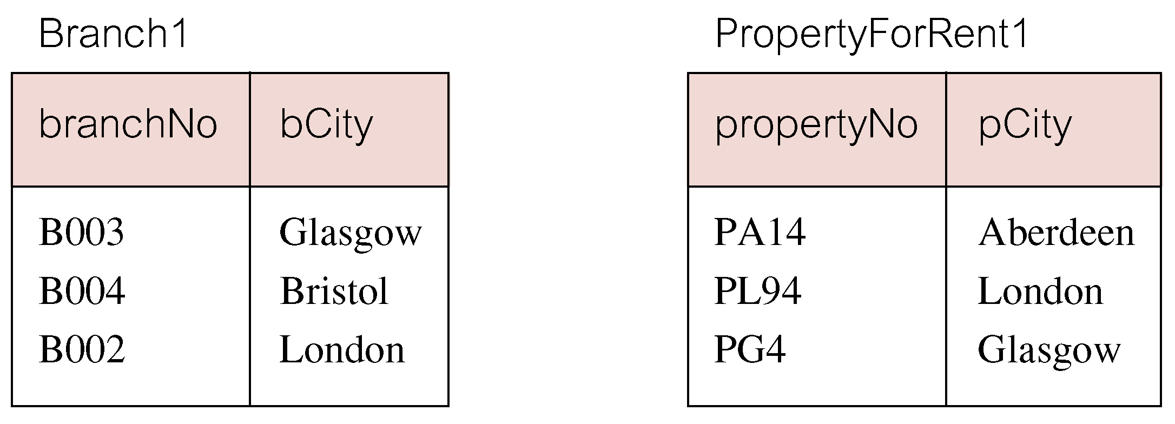
Outer Joins
If one row of a joined table is unmatched, row is omitted from result table.
Outer join operations retain rows that do not satisfy the join condition.
Consider following tables:

Slide 102
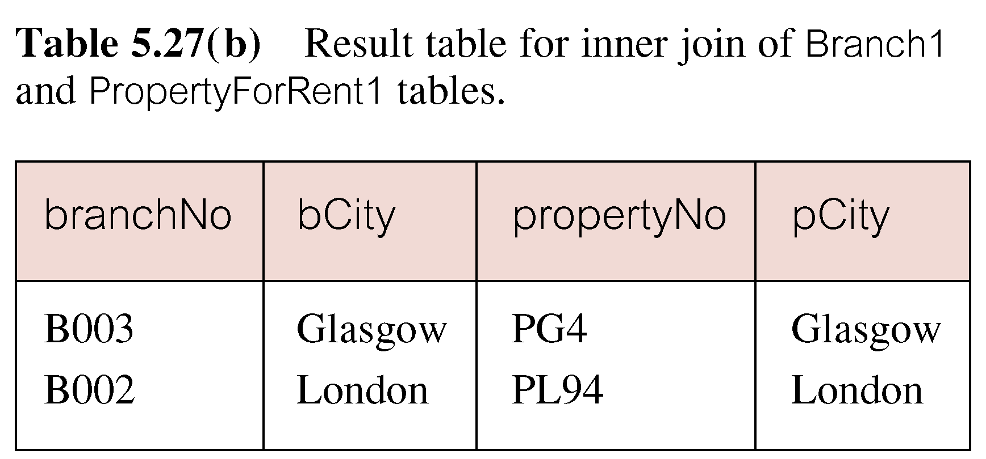
Outer Joins
The (inner) join of these two tables:
  SELECT b.*, p.*
    FROM Branch1 b,
    PropertyForRent1 p
    WHERE b.bCity = p.pCity;

Slide 103
Outer Joins
Result table has two rows where cities are same.
There are no rows corresponding to branches in Bristol and Aberdeen.
To include unmatched rows in result table, use an Outer join.

Slide 104
Example : Left Outer Join
◆List branches and properties that are in same city along with any unmatched branches.
SELECT b.*, p.*
  FROM Branch1 b LEFT JOIN
  PropertyForRent1 p
  ON b.bCity = p.pCity;

Slide 105
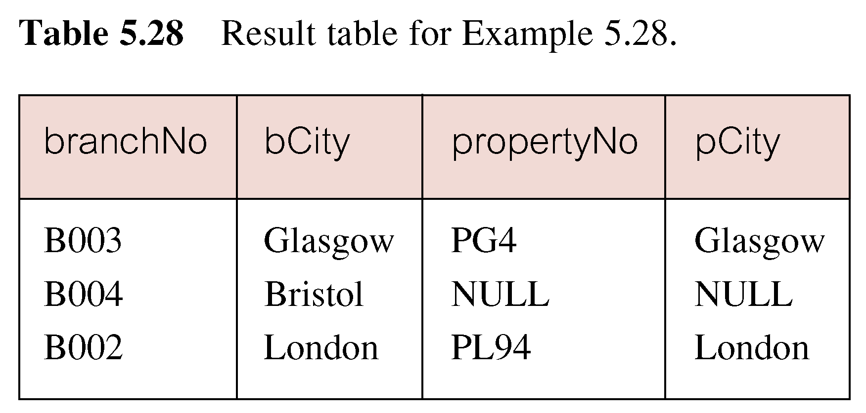
Example : Left Outer Join
Includes those rows of first (left) table unmatched with rows from second (right) table.
Columns from second table are filled with NULLs.

Slide 106
Example : Right Outer Join
◆List branches and properties in same city and any unmatched properties.
SELECT b.*, p.*
  FROM Branch1 b RIGHT JOIN
  PropertyForRent1 p
  ON b.bCity = p.pCity;

Slide 107
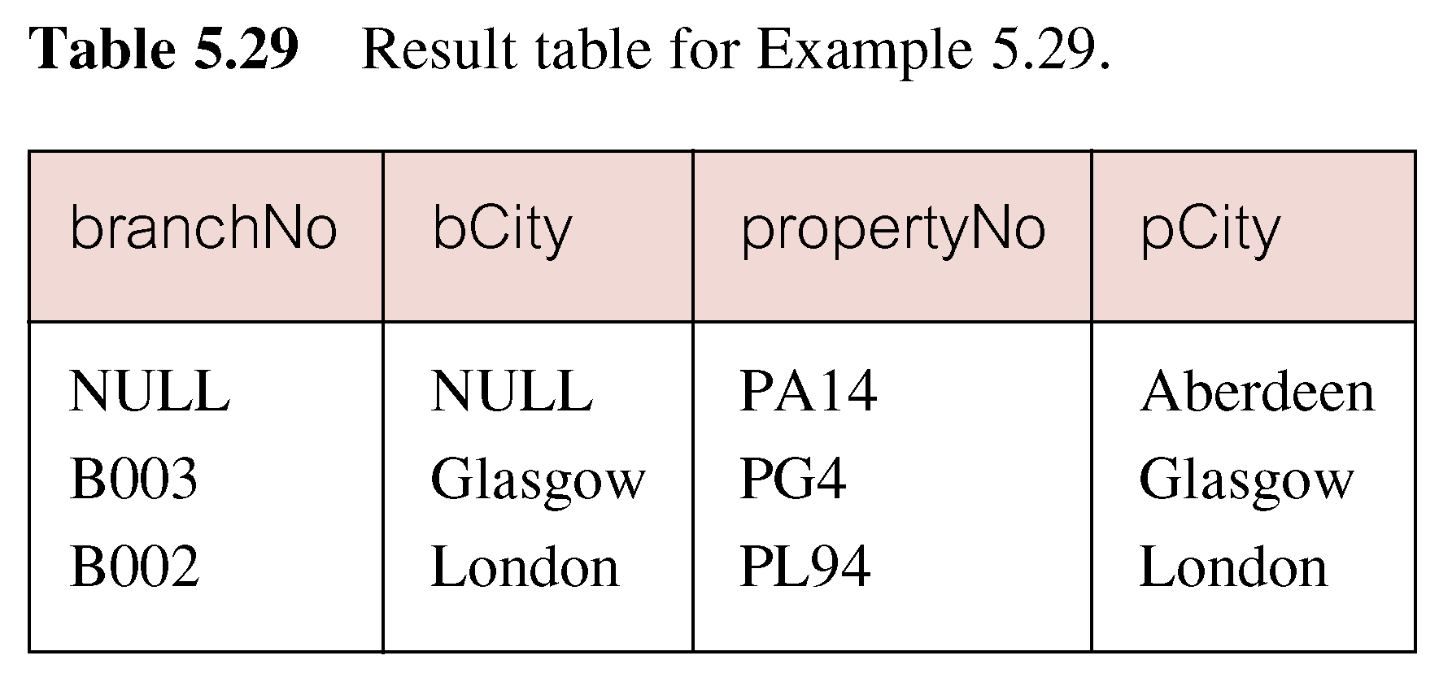
Example : Right Outer Join
Right Outer join includes those rows of second (right) table that are unmatched with rows from first (left) table.
Columns from first table are filled with NULLs.

Slide 108
Example : Full Outer Join
◆List branches and properties in same city and any unmatched branches or properties.
SELECT b.*, p.*
  FROM Branch1 b FULL JOIN
  PropertyForRent1 p
  ON b.bCity = p.pCity;

Slide 109
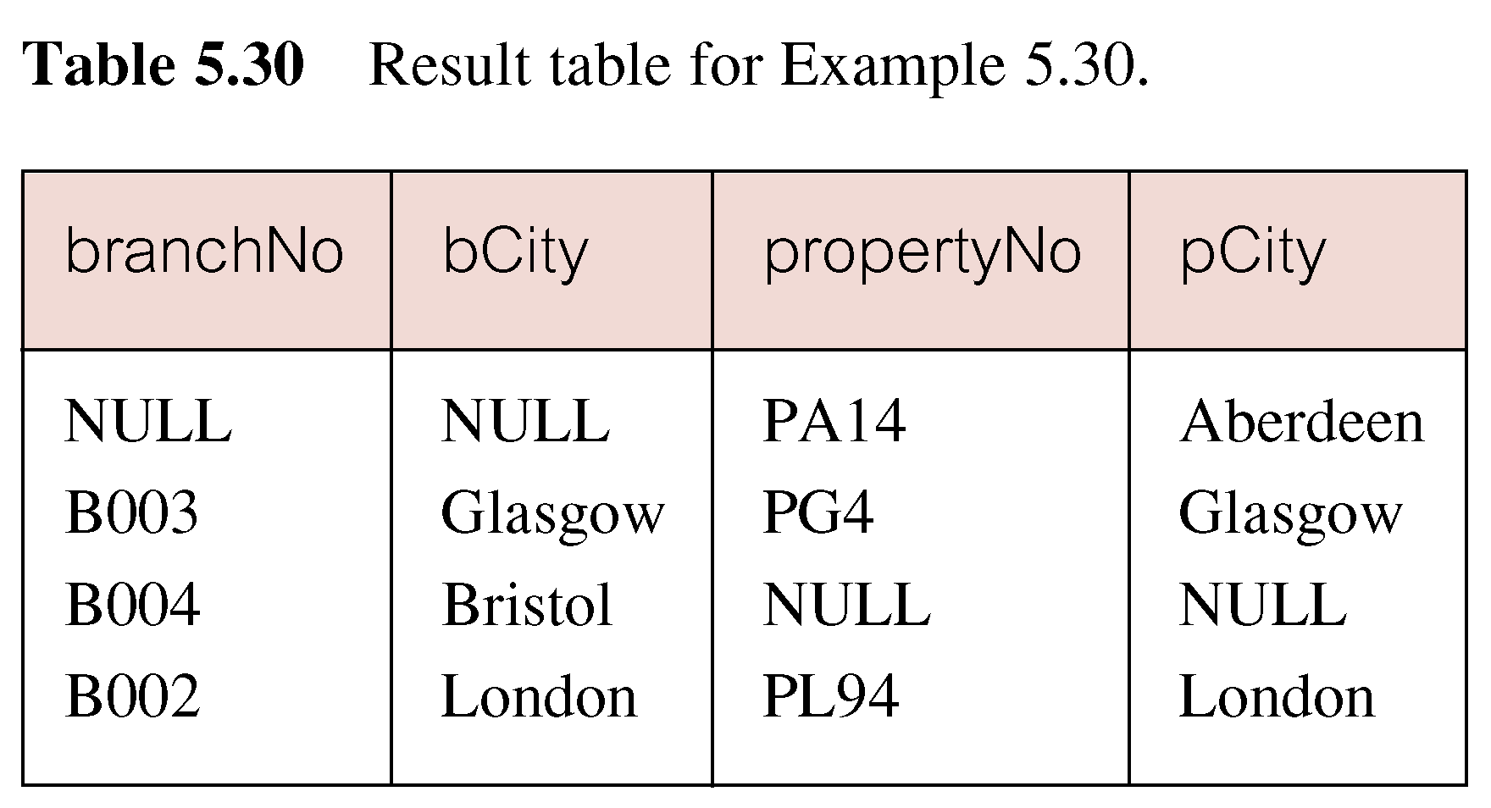
Example : Full Outer Join
Includes rows that are unmatched in both tables.
Unmatched columns are filled with NULLs.

Slide 110
example：student relation
S(SNO,SN,age,sex)
CREATE TABLE S
( SNO CHAR(4) NOT NULL,
SN CHAR(8) NOT NULL,
AGE SMALLINT,
SEX CHAR(1),
PRIMARY KEY (SNO) )；

Slide 111
example：course relation
C(CNO,CN,T, CREDIT )
CREATE TABLE C
( CNO CHAR(4) NOT NULL,
CN CHAR(8) NOT NULL,
T CHAR(10),
CREDIT SMALLINT,
PRIMARY KEY (CNO))；

Slide 112
example：student choice course relation
SC(SNO,CNO,G)
CREATE TABLE SC
( SNO CHAR(4) NOT NULL,
CNO CHAR(4) NOT NULL,
G SMALLINT,
PRIMARY KEY (SNO, CNO),
FOREIGN KEY(SNO)REFERENCES S(SNO),
FOREIGN KEY(CNO)REFERENCES C(CNO),
CHECK ((G IS NULL) OR (G BETWEEN 0
AND 100)))；

Slide 113
example1：list information of schoolgirl
select sno,sn,age
from s
where sex=‘F’；

Slide 114
eg2：list id and name of schoolgirl whose age greater than 18.
select sn,sno
from s
where age>18 and sex=‘F’；

Slide 115
eg3：list course information sorted by credit hour ascending
select cn, credit*16 as course_time
from c
order by course_time
Or:
select cn, credit*16 from c
order by 2

Slide 116
eg4：list student information sorted by birthday ascending ,if birth year is same then sort by id descending.
select sno,sn,2015-age as birthyear
from S
Order by birthyear,sno desc
Or:
select sno,sn,2015-age
from S
Order by 3,sno desc

Slide 117
Eg5: give column or expression an alias
select sn NAME,
’year of birth’ BIRTH,
2011-age BIRTHYEAR,
LOWER(sdept) DEPARTMENT
from s;

Slide 118
eg6：list id of DB_DESIGN course
Select cno From c
Where cn like ‘DB\_DESIGN’ ESCAPE ‘\’;
LIKE syntax：
[not] like ‘<matching>’ [ESCAPE ‘<transferred character>’]

Slide 119
eg7：list information of course, which name begin with ‘DB_’ and the third character of count backward is ‘I’
Select * From c
Where cn like ‘DB\_%i__’ ESCAPE ‘\’;

Slide 120
eg8：list information of student whose age is in range 17 and 18,sorted by age ascending
select sno,sn
from s
where age between 17 and 18
order by age

Slide 121
eg9：list detail of student who sign up for course but not took an examination
select s.sno,sn
from s，sc
where s.sno=sc.sno and g is null；

Slide 122
eg10：list student id and course id of student who take an examination
Select sno,cno
From sc
Where g is not null;

Slide 123
eg11：list id of student who take course 1 or course 2 as an elective course
Select sno
From sc
Where cno in (‘1’, ‘2’);

Slide 124
eg12： list student id of student who neither take course 1 as an elective course nor take course 2 as an elective course
Select sno
From sc
Where sno not in
(select sno
from sc
where cno=‘1’ )
and sno not in
(select sno
from sc
where cno=‘2’);

Slide 125
eg13：list id and name of student who take one course at least and score of the course equal to 95
select sno，sn
from s
where sno in
( select sno
from sc
where g = 95)；

Slide 126
eg14：list numbers and average age of schoolboy
Select count(*), AVG(age)
From s
Where sex=‘m’

Slide 127
eg15：list numbers of student who take courses
Select count(distinct sno)
From sc

Slide 128
eg16：list the highest score and the lowest score of course 2
Select max(g), min(g)
From sc
Where cno=‘c2’

Slide 129
eg17：list name of student who take course and numbers of course is greater than three
（id？）
select sn
from s
where sno in
( select sno
from sc
group by sno
having count(cno) >3 )

Slide 130
eg18：list name of schoolgirl whose average score is greater than 90
select sn
from s
where sex =‘F’ and sno in
(select sno
from SC
group by sno
having AVG(g )>90)；

Slide 131
Or:
select sn
from s，sc
where s.sno=sc.sno and sex= ‘F’
group by s.sno
having avg(g)>90 ；

Slide 132
eg19：list average score of course which is taught by teacher liu
SELECT CN,AVG(G)
FROM SC ,C
WHERE sc.cno=c.cno
and CNO IN
( SELECT CNO
FROM C
WHERE TN='LIU')
GROUP BY CN

Slide 133
eg20: list numbers of student who take course grouping by age
select age, count(distinct s.sno) from s,sc
where s.sno=sc.sno
group by age

Slide 134
eg21: statistic numbers of schoolboy grouping by age,sorted by numbers ascending,if numbers is same then sort by age descending,finally output numbers is greater than 50
(统计基本表S中男同学的每一年龄组（超过50人）的学生人数，要求查询结果按人数升序排列，人数相同按年龄降序排列。
select age, count(sno)
from s
where sex=‘M’
group by age
having count(*)>50
Order by 2,age desc
* sno yes/no? Yes!

Slide 135
Or:
select age, count(sno) as num
from s
where sex=‘M’
group by age
having count(*)>50
Order by num ,age desc

Slide 136
eg22：list information of student who take one course at least and score of the course equal to 95
select s.sno,sn,cno,g
from s, sc
where s.sno=sc.sno and g=95

Slide 137
eg23: list id of student who take course 1 or 2
select s.sno,sn
from s，sc
where s.sno=sc.sno
and (cno=‘c2’ or cno=‘c1’)；

Slide 138
eg24：list information of students and courses that they take as an elective course
Select s.*, sc.*
from s, sc
where s.sno=sc.sno;
Equal join
Omit duplicate property
Natural join
Select s.sno, sn, sex, age, cno, g
from s, sc
where s.sno=c.sno;

Slide 139
eg25：list id of student who take course c2 and c4 as elective course
select x.sno
from sc as x，sc as y
where x.sno=y.sno
and x.cno=‘c2’
and y.cno=‘c4’ ；

Slide 140
eg26：list id and name of student who have choosen course DB
select s.sno，sn
from s , sc ，c
where s.sno=sc.sno
and sc.cno=c.cno
and c.cn=‘DB’ ；

Slide 141
eg27: list id and name of student who take one course at least and score of the course equal to 95
（1）multiple base table join
select s.sno,sn
from s, sc
where s.sno=sc.sno and g=95

Slide 142
(2) Non Correlation subquery
select sno，sn
from s
where sno in (or=any)
( select sno
from sc
where g = 95)；

Slide 143
(3)Correlation subquery
select sno，sn from s
where exist
( select *
from sc
where s.sno=sc.sno and g = 95)；

Slide 144
select sno，sn from s
where exist
( select *
from sc
where s.sno=sc.sno
and g = 95)；
SC
sno | cno | G
s1 | c1 | 79
s1 | c3 | 85
s2 | c1 | 60
s2 | c2 | 83
s2 | c3 | 90
s3 | c1 | 83
s3 | c2 | 95
s4 | c1 | 75
s4 | c2 | 95
S
sno | sn | age | sex
s1 | 丁岩 | 19 | M
s2 | 王爽 | 17 | F
s3 | 李红 | 18 | F
s4 | 赵立 | 21 | M

Slide 145
eg28：list id and name of student who take course c2
select sno,sn from s
where exists
(select * from sc
where s.sno=sc.sno
and cno=‘c2’)；

Slide 146
select sno,sn
from s
where exists
(select * from sc
where s.sno=sc.sno
and cno=‘c2’)；
SC
sno | cno | G
s1 | c1 | 79
s1 | c3 | 85
s2 | c1 | 60
s2 | c2 | 83
s2 | c3 | 90
s3 | c1 | 95
s3 | c2 | 80
s4 | c1 | 75
s4 | c2 | 85
S
sno | sn | age | sex
s1 | 丁岩 | 19 | M
s2 | 王爽 | 17 | F
s3 | 李红 | 18 | F
s4 | 赵立 | 21 | M

Slide 147
result：
sno | sn
s2 | 王爽
s3 | 李红
s4 | 赵立

Slide 148
eg29：list id and name of student who take course “information system”
(3)
Select sno,sn
From s
Where sno in
(select sno
from sc
where cno in
(select cno
from c
where cn=‘information system’));
(2)
(1)

Slide 149
Or (with multiple table join)
Select sno,sn
From s, sc, c
Where s.sn=sc.sno and
c.cno=sc.cno and
c.cn=‘information system’；

Slide 150
eg30：list id and name of student who take course and score of all courses are greater than 90。
select sno，sn
from s
where 90 < ALL
( select g
from sc
where s.sno=sc.sno)；

Slide 151
eg31：list id and name of schoolboy who is older than all schoolgirls
select sno，sn
from s
where sex=‘m’ and age > ALL
( select age
from s
where sex=‘F’)；

Slide 152
eg32: list id and name of student who have taken course c2
select sno,sn from s
where sno in
(select sno from sc
where cno=‘c2’)；
or
select sno,sn from s
where sno = any
(select sno from sc
where cno=‘c2’)；

Slide 153
eg33：list id and name of student who have not taken course c2
select sno,sn from s
where sno not in
(select sno from sc
where cno=‘c2’)；
or
select sno,sn from s
where sno <> all
(select sno from sc
where cno=‘c2’)；

Slide 154
Review eg30：list id and name of student who take course and score of all courses is greater than 90。
SC
select sno，sn from s
where 90 < ALL
( select g
from sc
where s.sno=sc.sno)；
sno | cno | G
s1 | c1 | 79
s1 | c3 | 85
s2 | c1 | 60
s2 | c2 | 83
s2 | c3 | 90
s3 | c1 | 95
s3 | c2 | 93
s4 | c1 | 75
s4 | c2 | 85
S
sno | sn | age | sex
s1 | 丁岩 | 19 | M
s2 | 王爽 | 17 | F
s3 | 李红 | 18 | F
s4 | 赵立 | 21 | M

Slide 155
eg34：list name and age of student who is not in information department and whose age is smaller than any student of information department.
Select sn,age
from s
where sdept<>’IS’ and
age<any(select age
from s
where sdept=‘IS’);
or
Select sn,age
from s
where sdept<>’IS’ and
age<(select max(age)
from s
where sdept=‘IS’);

Slide 156
eg35：list name and age of student who is not in information department and whose age is smaller than all students of information department.
Select sn,age
from s
where sdept<>’IS’ and
age<all(select age
from s
where sdept=‘IS’);
or
Select sn,age
from s
where sdept<>’IS’ and
age<(select min(age)
from s
where sdept=‘IS’);

Slide 157
Review eg33：list id and name of student who have not taken course c2
select sno,sn from s
where not exists
(select * from sc
where s.sno=sc.sno
and cno=‘c2’)；
‘X’
Replace
*

Slide 158
eg36：list name of student who have not taken any course
select sn
from s
where not exist
( select *
from sc
where s.sno = sc.sno )

Slide 159
eg37：list name of student who have taken course c2
select sno,sn from s
where exists (select * from sc
where s.sno=sc.sno
and cno=‘c2’)；
or
select sno,sn from s
where sno in
(select sno
from sc
where cno=‘c2’)；

Slide 160
eg38：list id and name of student who have passed all taken courses
select sno，sn from s
where not exist
( select *
from sc
where s.sno=sc.sno
and g<60)；

Slide 161
select sno，sn from s
where not exist
( select *
from sc
where s.sno=sc.sno
and g<60)；
SC
sno | cno | G
s1 | c1 | 79
s1 | c3 | 85
s2 | c1 | 83
s2 | c2 | 56
s2 | c3 | 90
s3 | c1 | 95
s3 | c2 | 80
s4 | c1 | 85
s4 | c2 | 55
S
sno | sn | age | sex
s1 | 丁岩 | 19 | M
s2 | 王爽 | 17 | F
s3 | 李红 | 18 | F
s4 | 赵立 | 21 | M

Slide 162
Review eg36：list name of student who have not taken course C2
select sno,sn from s
where not exists
(select *
from sc
where s.sno=sc.sno
and cno=‘c2’)；

Slide 163
select sno,sn
from s
where not exists
(select * from sc
where s.sno=sc.sno
and cno=‘c2’)；
SC
sno | cno | G
s1 | c1 | 79
s1 | c3 | 85
s2 | c1 | 60
s2 | c2 | 83
s2 | c3 | 90
s3 | c1 | 95
s3 | c2 | 80
s4 | c1 | 75
s4 | c2 | 85
S
sno | sn | age | sex
s1 | 丁岩 | 19 | M
s2 | 王爽 | 17 | F
s3 | 李红 | 18 | F
s4 | 赵立 | 21 | M

Slide 164
eg39：list name of student who have taken all courses（相当于查询这样的学生，没有一门课是他不选的）
select sn from s
where not exists
( select * from c
where not exists
（select * from sc
where s.sno=sc.sno
and sc.cno=c.cno))；

Slide 165
S
sno | sn | age | sex
s1 | 丁岩 | 19 | M
s2 | 王爽 | 17 | F
s3 | 李红 | 18 | F
s4 | 赵立 | 21 | M
SC
sno | cno | G
s1 | c1 | 79
s1 | c3 | 85
s2 | c1 | 60
s2 | c2 | 83
s2 | c3 | 90
s3 | c1 | 95
s3 | c2 | 80
s4 | c1 | 75
s4 | c2 | 85
C
cno | cn | T
c1 | DB | li
c2 | Maths | liu
c3 | DS | zhang

Slide 166


result：
sno | sn
s2 | 王爽
( x)P= ┒( x(┒P))

Slide 167
Eg40: list id and name of student who have not taken course c2 and c4 at same time
select sno,sn
from s
where sno not in
( select distinct x.sno
from sc as x，sc as y
where x.sno=y.sno
and x.cno=‘c2’
and y.cno=‘c4’ )；

Slide 168
eg41：list id of student who take one course at least , and score of the course is greater than score of any course studied by s4 (查询至少有一门课超过学生s4一门成绩的学生学号)
select distinct sno
from sc
where grade > any
( select grade
from sc
where sno=‘s4’)；

Slide 169
eg42：list id of student who take one course at least , and score of the course is greater than score of all courses studied by s4(查询至少有一门课成绩超过学生s4所有课成绩的学生学号)
select distinct sno
from sc
where g > all
( select g
from sc
where sno=‘s4’)；

Slide 170
Eg43: list id of student whose average score of course is the highest
select distinct sno
from sc
group by sno
having avg(g) >= all
( select avg(g)
from sc
group by sno )；
★ “select max(avg(g))” ×

Slide 171
eg44：list id and average score of student whose average score of course is greater than 80
select distinct sno，avg(g)
from sc
group by sno
having avg(g) > 80
or：
select distinct sno，avg_g
from (select sno,avg(g)
from sc
group by sno ) result(sno,avg_g)
where avg_g > 80 ；

Slide 172
eg45：list information of teacher who teach only one course
select distinct T
from c as x
where unique ( select T
from c as y
where x.T=y.T )；
or：
select distinct T
from c
group by T
having count(*)=1

Slide 173
Database Modifications
A modification command does not return a result (as a query does), but changes the database in some way.
Three kinds of modifications:
  Insert a tuple or tuples.
  Delete a tuple or tuples.
  Update the value(s) of an existing tuple or tuples.

Slide 174
INSERT
INSERT INTO TableName [ (columnList) ]
  VALUES (dataValueList)
columnList is optional; if omitted, SQL assumes a list of all columns in their original CREATE TABLE order.
Any columns omitted must have been declared as NULL when table was created, unless DEFAULT was specified when creating column.

Slide 175
INSERT
dataValueList must match columnList as follows:
  number of items in each list must be same;
  must be direct correspondence in position of items in two lists;
  data type of each item in dataValueList must be compatible with data type of corresponding column.

Slide 176
Insertion
To insert a single tuple:
INSERT INTO <relation>
VALUES ( <list of values> );
Example: add to Likes(drinker, beer) the fact that Sally likes Bud.
INSERT INTO Likes
VALUES(’Sally’, ’Bud’);

Slide 177
Example INSERT … VALUES
Insert a new row into Staff table supplying data for all columns.
◆ INSERT INTO Staff
  VALUES (‘SG16’, ‘Alan’, ‘Brown’, ‘Assistant’, ‘M’, Date‘1957-05-25’, 8300, ‘B003’);

Slide 178
Specifying Attributes in INSERT
We may add to the relation name a list of attributes.
Two reasons to do so:
  We forget the standard order of attributes for the relation.
  We don’t have values for all attributes, and we want the system to fill in missing components with NULL or a default value.

Slide 179
Example: Specifying Attributes
Another way to add the fact that Sally likes Bud to Likes(drinker, beer):
INSERT INTO Likes(beer, drinker)
VALUES(’Bud’, ’Sally’);

Slide 180
Adding Default Values
In a CREATE TABLE statement, we can follow an attribute by DEFAULT and a value.
When an inserted tuple has no value for that attribute, the default will be used.

Slide 181
Example: Default Values
CREATE TABLE Drinkers (
name CHAR(30) PRIMARY KEY,
addr CHAR(50)
DEFAULT ’123 Sesame St.’,
phone CHAR(16)
);

Slide 182
Example: Default Values
INSERT INTO Drinkers(name)
VALUES(’Sally’);
Resulting tuple:
name address phone
Sally 123 Sesame St NULL

Slide 183
Example INSERT using Defaults
Insert a new row into Staff table supplying data for all mandatory columns.
◆INSERT INTO Staff (staffNo, fName, lName,
  position, salary, branchNo)
  VALUES (‘SG44’, ‘Anne’, ‘Jones’,
  ‘Assistant’, 8100, ‘B003’);
Or
  INSERT INTO Staff
  VALUES (‘SG44’, ‘Anne’, ‘Jones’, ‘Assistant’, NULL,
  NULL, 8100, ‘B003’);

Slide 184
Inserting Many Tuples
We may insert the entire result of a query into a relation, using the form:
INSERT INTO <relation>
( <subquery> );

Slide 185
INSERT … SELECT
Second form of INSERT allows multiple rows to be copied from one or more tables to another:
◆INSERT INTO TableName [ (columnList) ]
  SELECT ...

Slide 186
Example: Insert a Subquery
Using Frequents(drinker, bar), enter into the new relation PotBuddies(name) all of Sally’s “potential buddies,” i.e., those drinkers who frequent at least one bar that Sally also frequents.

Slide 187
Solution
The other
drinker
Pairs of Drinker
tuples where the
first is for Sally,
the second is for
someone else,
and the bars are
the same.
INSERT INTO PotBuddies
(SELECT d2.drinker
FROM Frequents d1, Frequents d2
WHERE d1.drinker = ’Sally’ AND
d2.drinker <> ’Sally’ AND
d1.bar = d2.bar
);

Slide 188
Example INSERT … SELECT
Assume there is a table StaffPropCount that contains names of staff and number of properties they manage:
  StaffPropCount(staffNo, fName, lName, propCnt)
Populate StaffPropCount using Staff and PropertyForRent tables.

Slide 189
Example INSERT … SELECT
  ◆ INSERT INTO StaffPropCount
  (SELECT s.staffNo, fName, lName, COUNT(*)
  FROM Staff s, PropertyForRent p
  WHERE s.staffNo = p.staffNo
  GROUP BY s.staffNo, fName, lName)
  UNION
  (SELECT staffNo, fName, lName, 0
  FROM Staff
  WHERE staffNo NOT IN
  (SELECT DISTINCT staffNo
  FROM PropertyForRent));

Slide 190
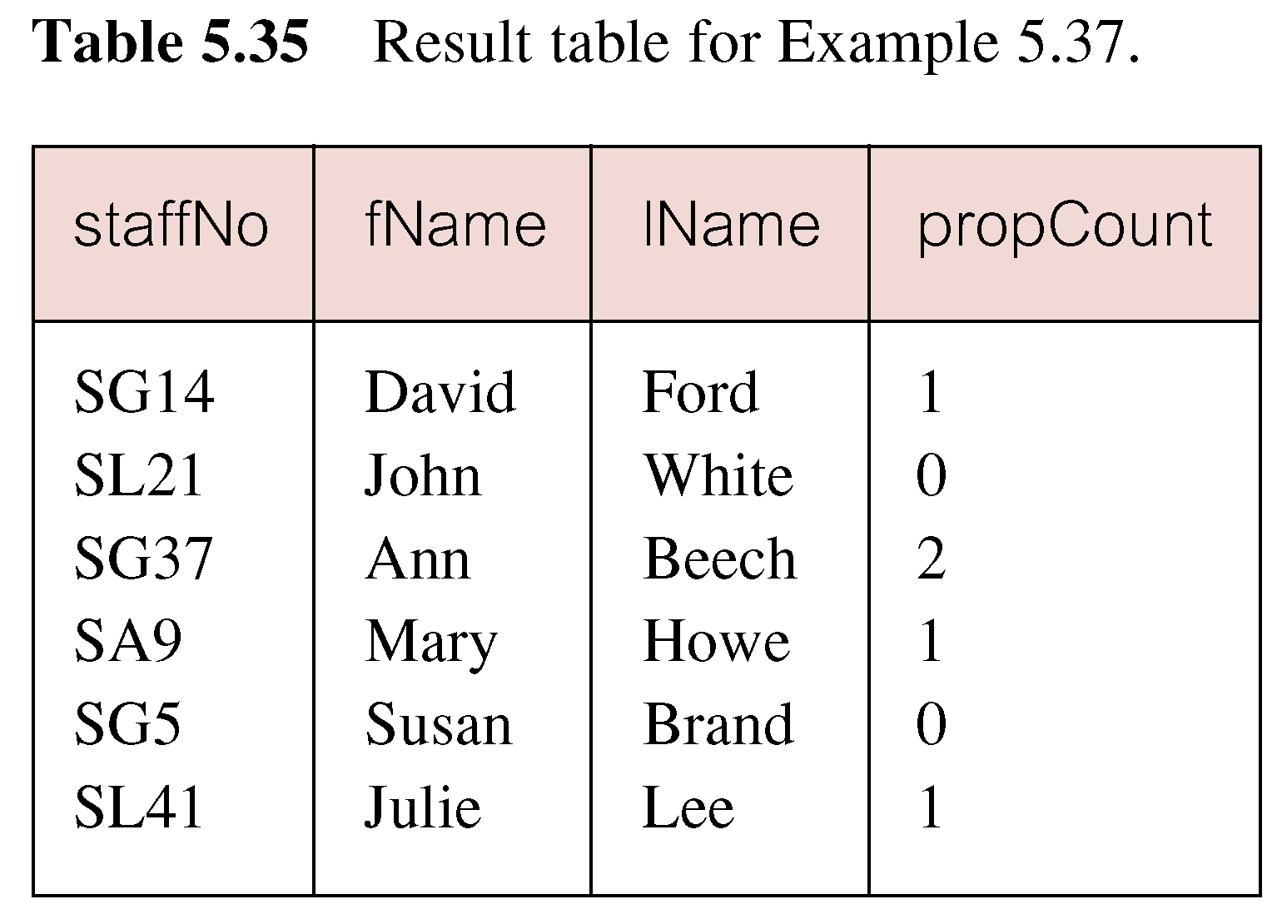
Example INSERT … SELECT
If second part of UNION is omitted, excludes those staff who currently do not manage any properties.

Slide 191
eg：store boy’s id and average score into table S_G(sno,avg_g),whose average score of course is over 80
◆ insert into s_g （ sno,avg_g)
Select sno, avg(g) from sc
Where sno in
( select sno
from s where
sex=‘m’)
Group by sno
Having avg(g) >80;

Slide 192
Eg: store student id,name,course id and score into table NoPass(sno ,sn ,cno,g) ,whose score of course is not passed
◆ insert into NoPass
select s.sno , sn , cno, g
from s , sc
where g <60 and
s.Sno =sc.Sno;

Slide 193
eg： store id,name and sex into table STUDENT（S＃，SANME，SEX） ,whose score of all elective course are over 80
◆ INSERT INTO STUDENT(S#,SNAME,SEX)
SELECT Sno,SNAME,SEX
FROM S WHERE
NOT EXISTS
(SELECT * FROM SC WHERE
G<80 AND S.Sno=SC.Sno);

Slide 194
Deletion
To delete tuples satisfying a condition from some relation:
DELETE FROM <relation>
WHERE <condition>;

Slide 195
DELETE
  DELETE FROM TableName
  [WHERE searchCondition]
TableName can be name of a base table or an updatable view.
searchCondition is optional; if omitted, all rows are deleted from table. This does not delete table. If search_condition is specified, only those rows that satisfy condition are deleted.

Slide 196
Example DELETE Specific Rows
Delete all viewings that relate to property PG4.
◆ DELETE FROM Viewing
  WHERE propertyNo = ‘PG4’;
Delete all records from the Viewing table.
  ◆ DELETE FROM Viewing;

Slide 197
Example: Deletion
Delete from Likes(drinker, beer) the fact that Sally likes Bud:
DELETE FROM Likes
WHERE drinker = ’Sally’ AND
beer = ’Bud’;

Slide 198
Example: Delete all Tuples
Make the relation Likes empty:
DELETE FROM Likes;
Note no WHERE clause needed.

Slide 199
Example: Delete Some Tuples
Delete from Beers(name, manf) all beers for which there is another beer by the same manufacturer.
DELETE FROM Beers b
WHERE EXISTS (
SELECT name FROM Beers
WHERE manf = b.manf AND
name <> b.name);
Beers with the same
manufacturer and
a different name
from the name of
the beer represented
by tuple b.

Slide 200
Semantics of Deletion --- (1)
Suppose Anheuser-Busch makes only Bud and Bud Lite.
Suppose we come to the tuple b for Bud first.
The subquery is nonempty, because of the Bud Lite tuple, so we delete Bud.
Now, when b is the tuple for Bud Lite, do we delete that tuple too?

Slide 201
Semantics of Deletion --- (2)
Answer: we do delete Bud Lite as well.
The reason is that deletion proceeds in two stages:
  Mark all tuples for which the WHERE condition is satisfied.
  Delete the marked tuples.

Slide 202
eg：delete elective course record of all student of computer department
Delete
from sc
where ‘cs’=(select sdept
from s where
s.sno=sc.sno);

Slide 203
Updates
To change certain attributes in certain tuples of a relation:
UPDATE <relation>
SET <list of attribute assignments>
WHERE <condition on tuples>;

Slide 204
UPDATE
  UPDATE TableName
  SET columnName1 = dataValue1
  [, columnName2 = dataValue2...]
  [WHERE searchCondition]
TableName can be name of a base table or an updatable view.
SET clause specifies names of one or more columns that are to be updated.

Slide 205
UPDATE
WHERE clause is optional:
  if omitted, named columns are updated for all rows in table;
  if specified, only those rows that satisfy searchCondition are updated.
New dataValue(s) must be compatible with data type for corresponding column.

Slide 206
Example: Update
Change drinker Fred’s phone number to 555-1212:
UPDATE Drinkers
SET phone = ’555-1212’
WHERE name = ’Fred’;

Slide 207
Example: Update Several Tuples
Make $4 the maximum price for beer:
UPDATE Sells
SET price = 4.00
WHERE price > 4.00;

Slide 208
Example UPDATE All Rows
Give all staff a 3% pay increase.
◆ UPDATE Staff
  SET salary = salary*1.03;
Give all Managers a 5% pay increase.
◆ UPDATE Staff
  SET salary = salary*1.05
  WHERE position = ‘Manager’;

Slide 209
Example UPDATE Multiple Columns
Promote David Ford (staffNo=‘SG14’) to Manager and change his salary to £18,000.
◆ UPDATE Staff
SET position = ‘Manager’, salary = 18000
WHERE staffNo = ‘SG14’;

Slide 210
eg：set elective course score of all student of computer department to zero
◆ Update sc
Set g=0
where ‘cs’=(select sdept
from s where
s.sno=sc.sno);

